Slide 1
CS234 – Multimedia Networking
Tuesdays, Thursdays 3:30-4:50p.m.
ICS 243
Prof. Nalini Venkatasubramanian
nalini@ics.uci.edu

Slide 2

Chapter 7
Multimedia Networking
Slides adapted from :
Computer Networking: A Top Down Approach
5th edition.
Jim Kurose, Keith Ross
Addison-Wesley, April 2009.
All material copyright 1996-2010
J.F Kurose and K.W. Ross, All Rights Reserved
Multimedia Networking
7-<number>

Slide 3
Multimedia Systems
Combination of media
    continuous and discrete.
  Levels of media-independence
    some media types (audio/video) tightly coupled, others not.
  Computer supported integration
    timing, spatial and semantic synchronization
Distributed multimedia communication systems
    data of discrete and continuous media are broken into individual units (packets) and transmitted.
Data Stream
    sequence of individual packets that are transmitted in a time-dependant fashion.
    Transmission of information carrying different media leads to data streams with varying features
      Asynchronous
      Synchronous
      Isochronous
Introduction to Multimedia

Slide 4
Data Stream Characteristics
    Asynchronous transmission mode
      provides for communication with no time restriction
      Packets reach receiver as quickly as possible, e.g. protocols for email transmission
    Synchronous transmission mode
      defines a maximum end-to-end delay for each packet of a data stream.
      May require intermediate storage
      E.g. audio connection established over a network.
    Isochronous transmission mode
      defines a maximum and a minimum end-to-end delay for each packet of a data stream. Delay jitter of individual packets is bounded.
      E.g. transmission of video over a network.
      Intermediate storage requirements reduced.
Introduction to Multimedia

Slide 5
Data Stream Characteristics
  Data Stream characteristics for continuous media can be based on
    Time intervals between complete transmission of consecutive packets
      Strongly periodic data streams - constant time interval
      Weakly periodic data streams - periodic function with finite period.
      Aperiodic data streams
    Data size - amount of consecutive packets
      Strongly regular data streams - constant amount of data
      Weakly regular data streams - varies periodically with time
      Irregular data streams
    Continuity
      Continuous data streams
      Discrete data streams
Introduction to Multimedia

Slide 6
Classification based on time intervals
Strongly periodic data stream
T
Weakly periodic data stream
T1
T2
T3
T
T
Aperiodic data stream
T1
T2
Introduction to Multimedia

Slide 7
Classification based on packet size
D1
T
t
Strongly regular data stream
D1
D1
T
D2
Weakly regular data stream
t
D3
D1
D2
D3
D1
D2
Irregular data stream
t
D3
Dn
Introduction to Multimedia

Slide 8
Classification based on continuity
Continuous data stream
D1
D2
D3
D4
D
D1
D2
D3
D4
D
Discrete data stream
Introduction to Multimedia

Slide 9
Logical Data Units
  Continuous media consist of a time-dependent sequence of individual information units called Logical Data Units (LDU).
      a symphony consists of independent sentences
      a sentence consists of notes
      notes are sequences of samples
  Granularity of LDUs
      symphony, sentence, individual notes, grouped samples
      film, clip, frame, raster, pixel
  Duration of LDU:
      open LDU - duration not known in advance
      closed LDU - predefined duration
Introduction to Multimedia

Slide 10
Granularity of Logical Data Units
Film
Clip
Frame
Blocks
Pixels
Introduction to Multimedia

Slide 11




Multimedia and Quality of Service: What is it?
multimedia applications: network audio and video
(“continuous media”)
QoS
network provides application with level of performance needed for application to function.
Multimedia Networking
7-<number>

Slide 12
Goals
Principles
classify multimedia applications
identify network services applications need
making the best of best effort service
Protocols and Architectures
specific protocols for best-effort
mechanisms for providing QoS
architectures for QoS
Multimedia Networking
7-<number>

Slide 13
Outline
Multimedia networking applications
Requirements for Multimedia Communication
    User and application requirements
    Processing and protocol constraints
    Mapping to OSI layers
Network QoS and Resource Management
  Providing multiple classes of service
  Negotiation, Translation, Admission
  Traffic Shaping, Rate Control, Error Control
  Monitoring, Adaptation
  Protocols for real-time interactive applications (RTP,RTCP,SIP)
Other Case Studies
    Fast Ethernet, FDDI, DQDB, ATM
Multimedia Networking
7-<number>

Slide 14
MM Networking Applications
Classes of MM applications:
1) stored streaming
2) live streaming
3) interactive, real-time
Fundamental characteristics:
typically delay sensitive
  end-to-end delay
  delay jitter
loss tolerant: infrequent losses cause minor glitches
antithesis of data, which are loss intolerant but delay tolerant.
  Jitter is the variability
  of packet delays within
  the same packet stream
Multimedia Networking
7-<number>

Slide 15
A few words about audio compression
analog signal sampled at constant rate
  telephone: 8,000 samples/sec
  CD music: 44,100 samples/sec
each sample quantized, i.e., rounded
  e.g., 2⁸=256 possible quantized values
each quantized value represented by bits
  8 bits for 256 values
example: 8,000 samples/sec, 256 quantized values --> 64,000 bps
receiver converts bits back to analog signal:
  some quality reduction
Example rates
CD: 1.411 Mbps
MP3: 96, 128, 160 kbps
Internet telephony: 5.3 kbps and up
Multimedia Networking
7-<number>

Slide 16
A few words about video compression
video: sequence of images displayed at constant rate
  e.g. 24 images/sec
digital image: array of pixels
  each pixel represented by bits
redundancy
  spatial (within image)
  temporal (from one image to next)
Examples:
MPEG 1 (CD-ROM) 1.5 Mbps
MPEG2 (DVD) 3-6 Mbps
MPEG4 (often used in Internet, < 1 Mbps)
Research:
layered (scalable) video
  adapt layers to available bandwidth
Multimedia Networking
7-<number>

Slide 17

Streaming Stored Multimedia
Stored streaming:
media stored at source
transmitted to client
streaming: client playout begins before all data has arrived
timing constraint for still-to-be transmitted data: in time for playout
Multimedia Networking
7-<number>

Slide 18
Streaming Stored Multimedia:
What is it?
Cumulative data
2. video
sent
1. video
recorded
3. video received,
played out at client
network
delay
time
streaming: at this time, client
playing out early part of video,
while server still sending later
part of video
Multimedia Networking
7-<number>

Slide 19
Streaming Stored Multimedia: Interactivity
VCR-like functionality: client can pause, rewind, FF, push slider bar
  10 sec initial delay OK
  1-2 sec until command effect OK
timing constraint for still-to-be transmitted data: in time for playout
Multimedia Networking
7-<number>

Slide 20
Streaming Live Multimedia
Examples:
Internet radio talk show
live sporting event
Streaming (as with streaming stored multimedia)
playback buffer
playback can lag tens of seconds after transmission
still have timing constraint
Interactivity
fast forward impossible
rewind, pause possible!
Multimedia Networking
7-<number>

Slide 21
Real-Time Interactive Multimedia
applications: IP telephony, video conference, distributed interactive worlds
end-end delay requirements:
  audio: < 150 msec good, < 400 msec OK
    includes application-level (packetization) and network delays
    higher delays noticeable, impair interactivity
session initialization
  how does callee advertise its IP address, port number, encoding algorithms?
Multimedia Networking
7-<number>

Slide 22
Requirements on Services and Protocols
  Audio/Video communication needs to be bounded by deadlines or defined by a time interval
    End-to-end jitter must be bounded
    End-to-end guarantees are required
  Synchronization mechanisms for different data streams are required
  Communication capability is required
    Communication of discrete data should not starve
  Fairness principle among applications, users and hosts is required
  Variable bit rate traffic support is required
Multimedia resource management

Slide 23
User and Application Requirements
  Data Throughput
      Application data have stream like behavior with high throughput
      Need to manipulate large APDU (application protocol data units in real-time)
  Fast Data Forwarding
      The faster a communication system can transfer a packet, fewer packets have to be buffered
  Service Guarantees - Proper resource management
  Multicasting
      Efficient sharing of resources
      Useful for reaching groups of users in applications such as video conferencing.
Multimedia resource management

Slide 24
Processing and protocol constraints
  Adapter-to-adapter transmission
      achieves fast transmission
      does not allow control over streams and QoS control
  Data movement in protocol stack
      requires expensive data copying
      need to explore other buffer management techniques and strategies.
  Segmentation and reassembly
      part of the protocol stack - these operations must be done efficiently.
  Retransmission error recovery
  Underlying network
      may provide many transmission modes
Multimedia resource management

Slide 25
OSI Layering
End-to-end protocol
End-point
End-point
Peer-to-Peer Comm.
Application Layer
Application Layer
Peer-to-Peer Comm.
Presentation Layer
Presentation Layer
Peer-to-Peer Comm.
Session Layer
Session Layer
Transport Layer
Peer-to-Peer Comm.
Transport Layer
Network Layer
Network Layer
Network Layer
Data Link Layer
Data Link Layer
Data Link Layer
Physical Layer
Physical Layer
Physical Layer
Switch/Router
Physical Medium (Fiber optics)
Multimedia resource management

Slide 26
Mapping of Requirements to OSI
  Physical Layer
    defines transmission methods of individual bits over a physical medium.
    For multimedia, need high bandwidth and minimal delay upto gigabit/terabit tranmission rates
      ATM switched with SONET physical layer deliver upto 2.4 and higher Gbps
  Data Link Layer
    defines transmission of blocks called data frames
      defines access protocols to physical medium, flow control and block synchronization
      E.g MAC (medium-access-control) sublayer defines Timed Token rotation protocol in Token Ring/FDDI and CSMA/CD protocol in Fast Ethernet
      Audio/video require reservations and throughput guarantees at this layer
      can also define mechanisms for error correction at this layer
Multimedia resource management

Slide 27
Mapping of requirements to OSI
  Network Layer
    defines transmission of information blocks called packets
    Services in this layer include addressing, inter-networking, error-handling, network management, congestion control, sequencing of packets, multi-casting
    Audio/video require reservation and guarantees at this layer.
      These requests for guarantees are defined by appropriate network QoS parameters.
    Audio/video requires connection-oriented behavior where reservations are made during connection setup.
    Reservation must be done along the path between the communication stations.
    Network QoS must be negotiated at this layer.
Multimedia resource management

Slide 28
Mapping of MM requirements to OSI
  Transport Layer
    provides a process to process connection
    In this layer, the network QoS is enhanced
      If the network service is poor, the transmission layer bridges the gap between what the transport user wants and what the network provides.
    Error handling is based on process-to-process communication.
    Error handling should not include retransmission for audio/video because this mechanism introduces high end-to-end delay.
    Synchronization and rate control should be supported.
Multimedia resource management

Slide 29
Mapping of MM requirements to OSI
  Session Layer
    This layer guarantees existence of multimedia connections during a whole multimedia session
      provides synchronization within a stream and among streams
      provides support for point-to-point session and multicast sessions.
  Presentation Layer
    This layer abstracts from different formats
    Includes services for transformation between application specific formats and the agreed upon transport format.
    Audio/video conversation is needed because many formats exist.
Multimedia resource management

Slide 30
Mapping of MM requirements to OSI
  Application Layer
    Audio/video need support for real-time access and transmission
    Audio/video services supported in this layer include playback, record, fast forward, rewind, pause etc..
Multimedia resource management

Slide 31
Outline
Multimedia networking applications
Requirements for Multimedia Communication
    User and application requirements
    Processing and protocol constraints
    Mapping to OSI layers
Network QoS and Resource Management
  Providing multiple classes of service
  Negotiation, Translation, Admission
  Traffic Shaping, Rate Control, Error Control
  Monitoring, Adaptation
MM over Internet
  Protocols for real-time interactive applications (RTP,RTCP,SIP)
Other Case Studies
    Fast Ethernet, FDDI, DQDB, ATM
Multimedia Networking
7-<number>

Slide 32
Network QoS and resource management
  Network QoS parameters include:
    end-to-end delay, jitter, packet rate, burst, throughput, packet loss.
  For establishment of a multimedia call, the following tasks must be performed:
    Application/user defines QoS parameters
    QoS parameters must be distributed and negotiated
    QoS parameters must be translated between the different layers.
    QoS parameters must be mapped to resource requirements.
    Required resources must be admitted, reserved and allocated along the path between the sender and receiver(s).
Multimedia resource management

Slide 33
Multimedia System/Network
Sender
Receiver
MM
Application
MM
Application
OS/DS/Network
OS/DS/Network
Network
CS 414 - Spring 2011

Slide 34
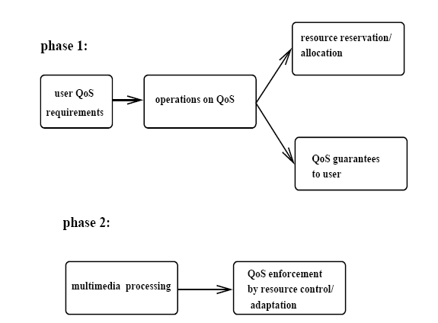
Relation between QoS and Resources (Phase 1)
Admission,
Reservation
Translation,
Negotiation
CS 414 - Spring 2011

Slide 35
Phase 1: Establishment Phase
(QoS Operations)
QoS Translation at different Layers
  User-Application
  Application-OS/Transport Subsystem
QoS Negotiation
  Negotiation of QoS parameters among two peers/components
CS 414 - Spring 2011

Slide 36
Phase 1: Connection Establishment
Sender
Logical Negotiation of
Application QoS Parameters
Receiver
MM
Application
MM
Application
Translation
OS/DS/Network
OS/DS/Network
Logical Negotiation of
Network QoS Parameters
Physical Transmission of
Negotiation Parameters
Network
CS 414 - Spring 2011

Slide 37
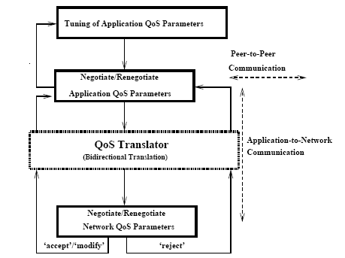
QoS Operations within Establishment Phase
User/Application
QoS Translation
Overlay P2P
QoS Negotiation
Application/Transport
QoS Translation
QoS Negotiation in
Transport Subsystem
CS 414 - Spring 2011

Slide 38
Example
Video Stream Quality:
  Frame size: 320x240 pixels, 24 bits (3 Bytes per pixel)
  Application frame rate RA: 20 fps
Translate to Network QoS if
  Assume network packet size is 4KBytes
  Network packet rate (RN):= ┌320x240x3┐ bytes / 4096 bytes
CS 414 - Spring 2011

Slide 39
Negotiation and translation
  For negotiation of network QoS, use peer-to-peer negotiation and triangular negotiation
  QoS Translation
    happens between QoS parameters specified in the application layer and required in the transport/network layer.
      (frame size M_a, frame rate R_a) to (throughput B_n, packet rate R_n)
      Assume frame size of 320x240 pixels, 8bits/pixel, frame rate 10fps. Assume packet size (M_n) is 4Kbytes.
      Throughput of the application is B_a = M_a * R_a = 6,144,000 bits/sec
      Packet rate R_n = (⎡ M_a/M_n⎤) * R_a = 190 packets/sec
      Network bandwidth B_n = M_n * R_n
Multimedia resource management

Slide 40
Reverse translation
Reverse translation is useful for adaptation and media scaling
  computes from (throughput, packet rate) the (frame-size, frame-rate)
  reverse translation is not unambiguous
  One can scale down either the frame size or the frame rate.
Multimedia resource management

Slide 41
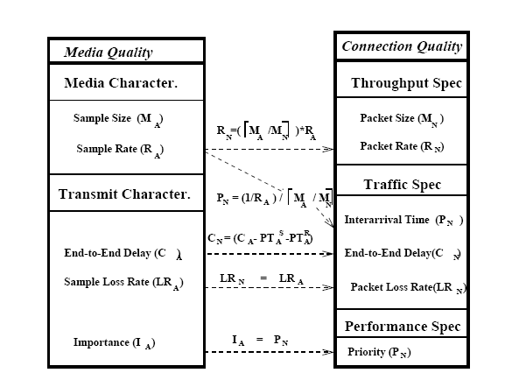
Layered Translation (Example)
CS 414 - Spring 2011

Slide 42
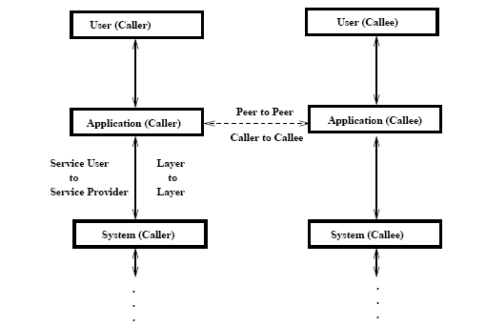
QoS Negotiation
CS 414 - Spring 2011

Slide 43
Different Types of Negotiation Protocols
Bilateral Peer-to-Peer Negotiation
  Negotiation of QoS parameters between equal peers in the same layer
Triangular Negotiation
  Negotiation of QoS parameters between layers
Triangular Negotiation with Bounded Value
CS 414 - Spring 2011

Slide 44
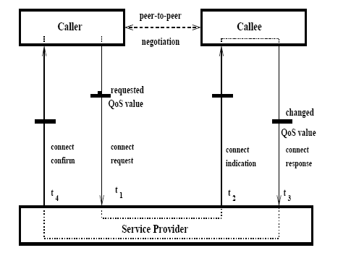
Bilateral QoS Negotiation
CS 414 - Spring 2011

Slide 45
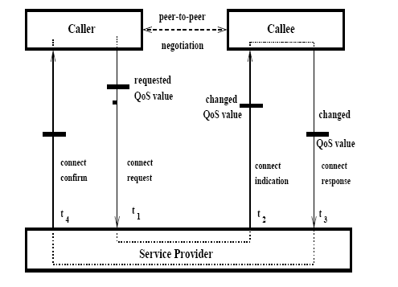
Triangular QoS Negotiation
CS 414 - Spring 2011

Slide 46
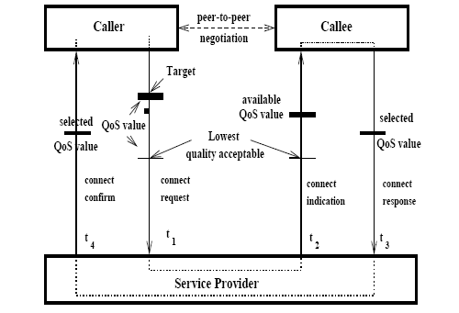
Triangular Negotiation with Bounded Value
CS 414 - Spring 2011

Slide 47
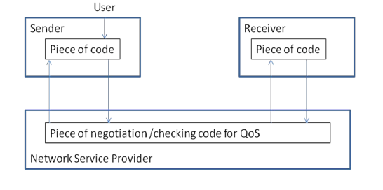

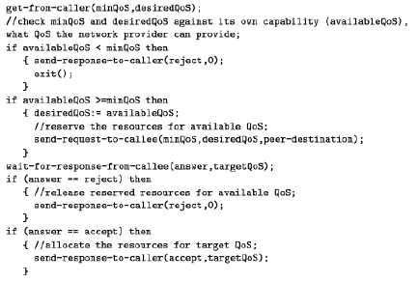
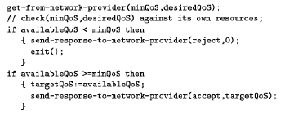
Triangular Negotiation Protocol (Pseudo-Code Example)
Caller
Callee
Caller Pseudo-Code
Network-Service Provider Pseudo-Code
Callee Pseudo-Code
CS 414 - Spring 2011

Slide 48
Multimedia Resource Management
Resource managers with operations and resource management protocols
    Various operations must be performed by resource managers in order to provide QoS
Phase 1: Establishment Phase (resource operations)
    Operations are executed where schedulable units utilizing shared resources must be admitted, reserved and allocated according to QoS requirements
Phase 2: Enforcement Phase
    Operations are executed where reservations and allocations must be enforced, and adapted if needed
CS 414 - Spring 2011

Slide 49
Phase 1: Resource Preparation Operations
QoS to Resource Mapping
  Need translation or profiling (e.g., how much processing CPU cycles, i.e., processing time, it takes to process 320x240 pixel video frame)
Resource Admission
  Need admission tests to check availability of shared resources
Resource Reservation
  Need reservation mechanisms along the end-to-end path to keep information about reservations
Resource Allocation
CS 414 - Spring 2011

Slide 50
Phase 1: Connection Establishment
Sender
Logical Negotiation of App
QoS Parameters
Receiver
MM
Application
MM
Application
Translation
OS/DS/Network
OS/DS/Network
Logical Negotiation of Net
QoS Parameters
System
Resource
Admission and
Reservation
Physical Transmission of
Negotiation Parameters
Network Resource
Reservation Protocol
Network
Network
Resource
Admission and
Resource Reservation
CS 414 - Spring 2011

Slide 51
Admission Tests
Task (System) schedulability tests for CPU resources
  This is done for delay guarantees
Network Packet schedulability tests for sharing host network interfaces, network switches
  This is done for network delay and jitter guarantees
Spatial tests for memory/buffer allocation
  This is done for delay and reliability guarantees
Network Link bandwidth tests
  This is done for network throughput guarantees
CS 414 - Spring 2011

Slide 52
Admission Control
  Throughput QoS maps to bandwidth resource.
  Packet-rate and error-rate map to scheduling and buffer resources
  Bandwidth allocation
    Let b_i be the reserved bandwidth for the ith connection and B_max the maximal bandwidth at the network interface.
    The admission test is
      ∑ b_i ≤ B_max
i=1,n
Multimedia resource management

Slide 53
Bandwidth Allocation
  In an iterative fashion, we consider
    AllocatedBW_i be the bandwidth already allocated to the ith connection
    RequestedBW_j be the bandwidth requested by the jth connection
    Let
      AvailableBW = B_max - ∑ AllocatedBW_i where i is not equal to j.
    The admission control test is
      RequestedBW_j <= AvailableBW
i=1,n
Multimedia resource management

Slide 54
Example - Admission Test
Consider an ATM host interface
    B_max = 130Mbps ( actual physical bandwidth of OC-3 host interface is 155Mbps, but at the network layer one gets approximately 130Mbps).
    Let b_1 of virtual circuit (vci1) = 1Mbps, b_2 of virtual circuit 2 (vci2) = 64kbps, b_3 of vci3 = 10Mbps
    the admission test is 11.064Mbps < 130Mbps and all three connections are admitted.
Multimedia resource management

Slide 55
Admission Control
  At network nodes (e.g. switches) we need to make scheduling decisions when admitting new streams
    need to make schedulability tests available
    Note that scheduling algorithms running on intermediate network noded are always non-preemptive.
  To schedule a packet through a network node on time, consider
    e_i is the processing time of packet i in microseconds
    Then the scheduling admission test is
      ∑ e_i ≤ 1, where I are all packets needed to be scheduled within the considered second.
i=1,n
Multimedia resource management

Slide 56
Scheduling Scenario at Network Node
Network resource
Input queue
Switch
Output queue
q_in
q_out
serve
e_i = q_in + serve + q_out
Multimedia resource management

Slide 57
Network Admission Control
  The processing time
    e_i = q_in + serve + q_out at a network node consists of
      q_in - the queueing delay of a connection packet in the input queue
      q_out - the queueing delay of a connection packet in the output queue
      serve - service time (equivalent to the switching time in a switch resource) of packet i.
    The serve time at a node is often constant due to hardware implementation. q_in, q_out times are variable times and depend on queue occupancy
      q = N/λ - Little’s theorem
      N is the occupancy of the queue in number of messages and λ is the arrival rate in messages per second to the queue.
Multimedia resource management

Slide 58
Resource Reservation and Allocation
Types of reservations
  Pessimistic approach - Worst case reservation of resources
  Optimistic approach - Average case reservation of resources
  Also sender vs. receiver oriented reservation protocol
To implement resource reservation we need:
  Resource table
    to capture information about managed table (e.g., process management PID table)
  Reservation table
    to capture reservation information
  Reservation function
    to map QoS to resources and operate over reservation table
CS 414 - Spring 2011

Slide 59
Network Resource Reservation
Bandwidth reservation
  Pessimistic
    maximal bandwidth allocation
      M_a = max_i(M_ai)
      B_n = M_n * (⎡ M_a/M_n⎤) * R_a
  Optimistic
    average bandwidth allocation
      M_a = 1/n ∑ M_ai
      B_n = M_n * (⎡ M_a/M_n⎤) * R_a
i=1,n
Multimedia resource management

Slide 60
Reservation/Allocation protocols
Sender-oriented vs. Receiver oriented protocol
  Sender oriented reservation
    sender transmits a QoS specification to the targets
    intermediate routers and targets may adjust the QoS spec wrt available resources before the QoS specification is transmitted back to the sender.
  Receiver oriented reservation
    receiver describes resource requirements in a QoS specification and sends it to the sender in a “reservation” message.
    Assumes that sender has sent a path message before, providing information about outgoing data.
Multimedia resource management

Slide 61
Sender oriented reservation protocol
Admit/allocate
Admit/reserve
Send reservation message
Admit/reserve
Admit/reserve
Transmission
flow
reserve
allocate
transmit
Multimedia resource management

Slide 62
Receiver oriented reservation protocol
Admit/reserve
Admit/allocate
Send reservation message
Admit/reserve
Admit/reserve
Transmission
flow
reserve
allocate
transmit
Multimedia resource management

Slide 63
Reservation Styles
  Represents the creation of a path reservation and time when senders and receivers perform QoS negotiation and resource reservation
  Sender based reservation
      single reservation or multicast reservation
  The IETF standard defined three types of reservation styles (RSVP) for receiver oriented reservation
    Wildcard Style
      allows receiver to create a single reservation along each link shared among all senders for the given session
    Fixed Filter Style
      allows each receiver to create a single reservation from a particular sender whose data packets it wants to receive
    Dynamic Filter Style
      allows each receiver to create N reservations to carry flows from up to N different senders. This style allows the receiver to do channel switching
Multimedia resource management

Slide 64
Reservation Styles
Wildcard filter
Fixed filter
Dynamic filter
Multimedia resource management

Slide 65
End-to-end Error Control
  Many MM communication systems offer unreliable transport
      UDP/IP protocol was used for transmitting digital audio over the Internet
      Tenet protocol suite’s transport protocols provide unreliable but timely delivery for MM communication
  Reliability needed in multimedia communication
    Decompression
      many compression schemes cannot tolerate loss
    Human perception
      loss of audio detected very quickly
    Data Integrity
      recording application - cannot recover from error in first recording
Multimedia Networking

Slide 66
End-to-end Error Control
  Error Detection
    Traditional mechanisms
      checksumming, PDU sequencing.
      Allow detection of data corruption, loss etc. at lower level
    MM needs
      byte error detection at the application PDU level
      time detection - late PDU is useless
  Error Correction
    Traditional mechanisms
      retransmission using acknowledgement schemes and/or window based flow control
      amount of data to be stored at sender too large
      sender may be forced to suspend transmission (window based)
      retransmitted data may be too late
      not designed for multicasting
Multimedia Networking

Slide 67
MM Error Correction Algorithms
    Go-back-N retransmission
      If PDU j is lost, sender will go back to j and restart transmission from j (if j<=n).
      Problems - gap introduction, violation of throughput guarantees
    Selective retransmission
      receiver sends negative ack if PDU j<=n is lost. Sender retransmits only those PDUs reported missing
      receiver has to store successfully delivered PDU until all previous Pdus have been delivered successfully.
    Partially reliable streams
      limits number of packets that will be retransmitted in a time interval.
    Forward error correction
      sender sends additional information that the receiver can locate and correct bits or bit sequences. Requires H/w support
    Priority channel coding
      separate medium into multiple data streams with diff priorities
    Slack automatic repeat request.
      Retransmission of lost voice packets in high speed LANs.
Multimedia Networking

Slide 68
Go-back-N retransmission scheme
Packet in
receiver
buffer
Playout time
gap
Corrupted packet
Retransmitted packet
Gap problem in Go-back-N transmission scheme
Multimedia Networking

Slide 69
Slack Automatic Repeat Request
Talk spurt
Packetization intervals
Voice
sampling
1
2
3
4
5
Packetization
time
Protocol processing and
network delay
time
Retransmission
Arrival at
receiver
time
Playback
time
Control time
1
3
4
5
With jitter control
gaps
Control time
1
2
3
4
5
With jitter control and retransmission
Extended Control time
1
2
3
4
5
With jitter control and S-ARQ
Multimedia Networking

Slide 70
Monitoring
  Network Management
    consists of monitoring agents at every intermediate node that:
      gather information and store it in MIB (management information base)
      exchange information among each other
      convey information to other resource managers
    Standard network management (administration) protocols
      CMIS/CMIP (common management information services and protocols) for wide-area networks
      SNMP (Simple network management protocol) - IP based
    Monitoring for MM transmission - possible QoS violations
      monitoring variables should be optional
      must be able to turn monitoring on and off.
Multimedia Networking

Slide 71
Adaptation Schemes
  Network Adaptation
    For network to adapt, we need efficient routing and resource allocation.
    Load balancing scheme needs services such as
      routing, performance monitoring (detecting load changes), dynamic re-routing (changing the route), load balancing control (making a decision to re-route)
  Source Adaptation
    Feedback from the network to the source needed or feedback from other peer
    adaptive rate control
    traffic shaping
    hierarchical coding
Multimedia Networking

Slide 72
Adaptive Applications
  Essential Idea
      Instead of requiring the network to make strict performance guarantees, the application asks for loose performance guarantees and the application changes its behavior to accommodate to how the network is currently delivering data.
    Example application - VAT (voice conferencing system)
      experimental use over Internet
      Challenge of supporting a phone conversation - maintaining correct spacing between samples
      To avoid garbled output due to variation in transit times through network, adaptive applications buffer the voice samples at the receiver. The inter-sample timing is recreated by the receiver before the samples are played.
      Vat recreates timing by having sender time-stamp each sample. Receiver used time-stamps to restore the inter-sample timing.
Multimedia Networking

Slide 73
Adaptive Applications (cont.)
  Make receiving buffers large enough
    samples delayed in the network will arrive in time to be played.
      If the network delay for a sample varies between 50-100ms, receiver buffer must store up to 50ms worth of data.
      Voice samples that arrive in less than 100ms are buffered until 100ms have elapsed since they were sent and then played.
    Choosing a Playback point - time at which voice samples are played back is hard
      vat changes the playback point during conversation in response to the network delays it observes.
      If all samples are arriving late, increase playback point
      If all samples are arriving well before they are played, move the playback point back.
Multimedia Networking

Slide 74
MM Communication Protocols
-Heidelberg Protocol Stack
Heidelberg Continuous Media Realm
Heidelberg Resource Administration Technique
Stream Protocol (ST-II)
Connection-oriented, guaranteed service
ST Control Message Protocol, ST
Resource reservation, flow specification with QoS
Multimedia Networking

Slide 75
MM Communication Protocols
-Tenet Protocol Stack
Real-time Message Transport Protocol (RMTP)
connection-oriented, performance guaranteed
unreliable message delivery
Flow control: rate control
Continuous Media Transport Protocol (CMTP)
transport of periodic network traffic with performance guarantees
Real-time Channel Administration Protocol (RCAP)
resource reservation, admission, QoS handling
Real-time Channel Internet Protocol (RTIP)
connection oriented, performance guaranteed
unreliable delivery of packets
Multimedia Networking

Slide 76
MM Communication Protocols
- XTP Protocol Stack
Services
connection, transaction, unacknowledged datagram,
acknowledged datagram, isochronous stream, bulk data
Users (contexts)
create an association
Flow control
sliding window or rate based flow control
window-based flow control uses a combined mechanism between
cumulative acknowledgement and selective acknowledgement
Error control
Mechanisms and policies - can be customized
Connection-oriented transmission
Good for ATM - fast connection establishment
Problems: large headers, software implementation slow
Multimedia Networking

Slide 77

How should the Internet evolve to better support multimedia?
Integrated services philosophy:
fundamental changes in Internet so that apps can reserve end-to-end bandwidth
requires new, complex software in hosts & routers
Laissez-faire
no major changes
more bandwidth when needed
content distribution, application-layer multicast
  application layer
Differentiated services philosophy:
fewer changes to Internet infrastructure, yet provide 1st and 2nd class service
What’s your opinion?
Multimedia Networking
7-<number>

Slide 78
Streaming Stored Multimedia
application-level streaming techniques for making the best out of best effort service:
  client-side buffering
  use of UDP versus TCP
  multiple encodings of multimedia
Media Player
jitter removal
decompression
error concealment
graphical user interface
w/ controls for interactivity
Multimedia Networking
7-<number>

Slide 79
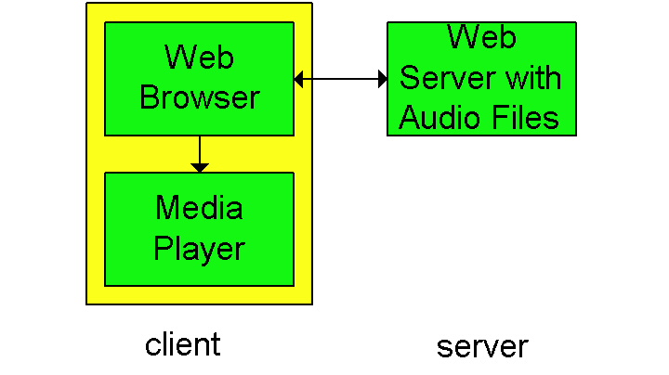
Internet multimedia: simplest approach
audio or video stored in file
files transferred as HTTP object
  received in entirety at client
  then passed to player
audio, video not streamed:
no, “pipelining,” long delays until playout!
Multimedia Networking
7-<number>

Slide 80
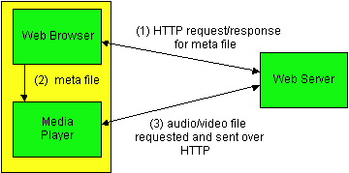
Internet multimedia: streaming approach
browser GETs metafile
browser launches player, passing metafile
player contacts server
server streams audio/video to player
Multimedia Networking
7-<number>

Slide 81
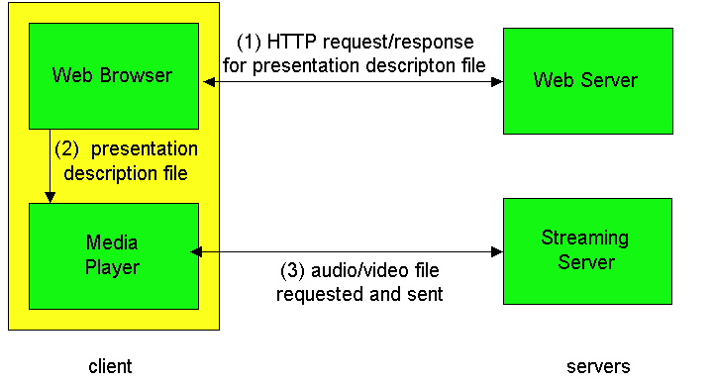
Streaming from a streaming server
allows for non-HTTP protocol between server, media player
UDP or TCP for step (3), more shortly
Multimedia Networking
7-<number>

Slide 82
Streaming Multimedia: Client Buffering
constant bit
rate video
transmission
client video
reception
constant bit
rate video
playout at client
Cumulative data
variable
network
delay
buffered
video
client playout
delay
time
client-side buffering, playout delay compensate for network-added delay, delay jitter
Multimedia Networking
7-<number>

Slide 83
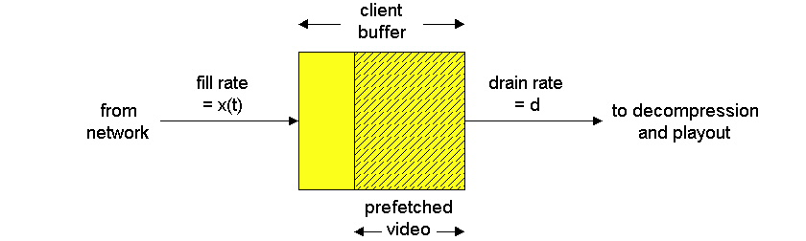
Streaming Multimedia: Client Buffering
constant
drain
rate, d
variable fill
rate, x(t)
buffered
video
client-side buffering, playout delay compensate for network-added delay, delay jitter
Multimedia Networking
7-<number>

Slide 84
Streaming Multimedia: UDP or TCP?
UDP
server sends at rate appropriate for client (oblivious to network congestion !)
  often send rate = encoding rate = constant rate
  then, fill rate = constant rate - packet loss
short playout delay (2-5 seconds) to remove network jitter
error recover: time permitting
TCP
send at maximum possible rate under TCP
fill rate fluctuates due to TCP congestion control
larger playout delay: smooth TCP delivery rate
HTTP/TCP passes more easily through firewalls
Multimedia Networking
7-<number>

Slide 85

Streaming Multimedia: client rate(s)
1.5 Mbps encoding
28.8 Kbps encoding
Q: how to handle different client receive rate capabilities?
  28.8 Kbps dialup
  100 Mbps Ethernet
A: server stores, transmits multiple copies of video, encoded at different rates
Multimedia Networking
7-<number>

Slide 86
User Control of Streaming Media: RTSP
HTTP
does not target multimedia content
no commands for fast forward, etc.
RTSP: RFC 2326
client-server application layer protocol
user control: rewind, fast forward, pause, resume, repositioning, etc…
What it doesn’t do:
doesn’t define how audio/video is encapsulated for streaming over network
doesn’t restrict how streamed media is transported (UDP or TCP possible)
doesn’t specify how media player buffers audio/video
Multimedia Networking
7-<number>

Slide 87
RTSP: out of band control
FTP uses an “out-of-band” control channel:
file transferred over one TCP connection.
control info (directory changes, file deletion, rename) sent over separate TCP connection
“out-of-band”, “in-band” channels use different port numbers
RTSP messages also sent out-of-band:
RTSP control messages use different port numbers than media stream: out-of-band.
  port 554
media stream is considered “in-band”.
Multimedia Networking
7-<number>

Slide 88
Outline
Multimedia Protocols – Standards
  RTP/UDP/IP – Transmission Protocol
  RTCP Control/Negotiation Protocol to RTP
  RTSP – Control VOD Negotiation Protocol
CS 414 - Spring 2011

Slide 89
Internet Multimedia Protocol Stack
Media encaps
(H.264, MPEG-4)
APPLICATION
SIP
RTSP
RSVP
RTCP
Layer 5
(Session)
RTP
TCP
Layer 4
(Transport)
DCCP
UDP
KERNEL
IP Version 4, IP Version 6
Layer 3
(Network)
AAL3/4
AAL5
MPLS
Layer 2
(Link/MAC)
ATM/Fiber Optics
Ethernet/WiFi
CS 414 - Spring 2011

Slide 90
Service Requirements for Real-time Flows (Voice/Video)
Sequencing
Intra-media synchronization
Inter-media synchronization
Payload identification
Frame indication
CS 414 - Spring 2011

Slide 91
TCP - Transmission Control Protocol
TCP provides
    reliable, serial communication path between processes exchanging a full-duplex stream of bytes.
    Full-duplex TCP connections
    sequential delivery (no reordering required);
    reliable delivery, achieved through retransmission on timeouts and positive acknowledgement on receipt of information.
    Flow control, based on window technique
  Not suitable for multimedia transmission
    led to TCP enhancements
Multimedia Networking

Slide 92
Techniques for Going Faster
  Improve protocol implementation
      Memory management - reduce copying
      Interrupt handling - clocked interrupts
  Better Lookup Techniques
    IP must find a route to be able to send an IP packet
      use caches of frequently used information, find lookup algorithms
    Caches - maximize hit rate, minimize search and maintenance (conflict)
      most effective - small caches
      packets travel in packet trains
    Lookup Algorithms
      for transaction processing; hashing using open chaining, where head of each hashed link list keeps a cache of the last accessed control block.
Multimedia Networking

Slide 93
Reducing or Eliminating Checksum Cost
  Computing checksum
      requires that each byte in the packet be read and added into sum
    In RISC processors, two instructions per cycle are possible. Include checksum into instructions
    One could leave out the checksum
    Move checksum to the end of the packet
      trailing checksums, which results in send being faster, but it doesn’t affect receiver.
\load [%r0], %r2
\add %r5, %r2, %r5
\add %r5, #0, %r5
\store %r2, [%r1]
\load [%r0], % r2
\store %r2, [%r1]
Multimedia Networking

Slide 94
Prediction
  TCP has many features
      retransmission, window sizes, urgent data, however these features are expensive to implement.
    TCP behavior is highly predictable
      one can take advantage by optimizing the frequent path through the TCP code at the sender and receiver.
    Algorithm for TCP receivers
      header prediction, looks for segment that fits the profile of the segment the receiver expects to receive next.
Multimedia Networking

Slide 95
Sequence Numbers
  Sequence Numbers
      High delay-bandwidth product has an implication on the TCP window size and sequence space. TCP window size is 64 Kbytes
      we need possibility to negotiate the window size.
      Wrap-around counters to put in sequence numbers
  Example
    In case of 10Mbps
      IP packet lifetime was designed with 120 seconds and sequence space of 32 bits
      takes 1700 seconds to send 2^31 bytes with this throughput
    In case of Gigabits/sec
      takes 17 seconds to send 2^31 bytes
Multimedia Networking

Slide 96
Flow and Congestion Control
  High delay-bandwidth product causes
    long time to tell sender to slow down
    E.g. New York to LA, TCP continues to send packets for about 30ms before it hears request from LA receiver.
  Slow-start algorithm
    flow and congestion control mechanism
  Probing algorithm
    requires sender to keep congestion window which is the estimate of how much traffic the network can actually take.
    Congestion window is managed using 2 part algorithm
      Sender sends exponentially until segment gets lost
      Sender sends exponentially up to half of previous window, then the window grows linearly.
Multimedia Networking

Slide 97
User Datagram Protocol
  UDP is an extension of IP
    supports multiplexing of datagrams
    supports checksumming
    Higher level protocols using UDP must provide:
      retransmission
      packetization
      reassembly
      flow control
      congestion avoidance
    UDP by itself is not suitable for MM transmission, but many MM protocols reside on top of UDP.
      Provides to some degree the real-time transport property.
Multimedia Networking

Slide 98
Internet Services and Protocols
  Internet protocol changed to provide integrated services (differential services)
    best-effort service, real-time service and controlled link sharing.
  IP provides unreliable delivery of datagrams in a point-to-point fashion.
  IP provides types of services (TOS) which can be used for indication of service quality. TOS specifies:
    precedence relation
    services such as minimize delay, maximize throughput, maximize reliability, minimize monetary cost.
Multimedia Networking

Slide 99
Addressing and Routing
  Five classes of addresses:
    Class A
      24 bits for host addressing and 7 bits for network
    Class B
      16 bits for host addressing and 14 bits for network
    Class C
      8 bits for host addressing and 21 bits for network
    Class D
      Multicast Address (multicast tree)
    Class E
      for future extensions
Multimedia Networking

Slide 100
Addressing and Routing
  Interconnectivity of IP and underlying protocols
    via binding of IP addresses to lower layer network addresses.
    E.g. ARP (address resolution protocol) maps IP addresses to 48 bit Ethernet addresses.
  Routing - IP uses
    Interior Gateway Protocol within autonomous systems (Open Shortest Path First)
    Exterior Gateway Protocol or Border Gateway Protocol among autonomous systems
  For MM communication
    we will need QoS routing algorithms with new protocols
Multimedia Networking

Slide 101
Real-time Transmission Protocol (RTP)
RTP provides end-to-end transport functions suitable for real-time audio/video applications over multicast and unicast network services
RTP companion protocol – Real-time Transport Control Protocol (RTCP)
RTP
RTCP
Layer 4
User Datagram Protocol
Internet Protocol
Ethernet 802.13 or Wi-Fi 802.11
PHY (Wired or Wireless)
CS 414 - Spring 2011

Slide 102
Relation between RTP and RTCP
Application
Application
Decoding
Coding
Coding
Decoding
RTP
RTCP
RTCP
RTP
UDP/IP
UDP/IP
CS 414 - Spring 2011

Slide 103
RTCP: Control and Management
Out-of-band control information for RTP flow.
  Monitors QoS for RTP in the delivery and packaging of multimedia data
  Used periodically to transmit control packets to participants in a streaming multimedia session.
  Provides feedback on the quality of service being provided by RTP.
  Gathers statistics on media connection
    Bytes sent, packets sent, lost packets, jitter, feedback and round trip delay.
    Application may use this information to increase the quality of service, perhaps by limiting flow or using a different codec.
CS 414 - Spring 2011

Slide 104
RTCP Functions
There are several type of RTCP packets:
  Sender report packet,
  Receiver report packet,
  Source Description RTCP Packet,
  Goodbye RTCP Packet and
  Application Specific RTCP packets.
RTCP itself does not provide any flow encryption or authentication means. SRTCP protocol can be used for that purpose.
CS 414 - Spring 2011

Slide 105
RTP Services
Payload Type Identification
  Determination of media coding
  Source identification
  RTP works with Profiles
    Profile defines a set of payload type codes and their mappings to payload formats
Sequence numbering
  Error detection
Time-stamping
  Time monitoring, synchronization, jitter calculation
Delivery monitoring
CS 414 - Spring 2011
Notes:
, the services provided by RTP include:
Payload-type identification - Indication of what kind of content is being carried
Sequence numbering - PDU sequence number
Time stamping - allow synchronization and jitter calculations
Delivery monitoring
The protocols themselves do not provide mechanisms to ensure timely delivery. They also do not give any Quality of Service (QoS) guarantees. These things have to be provided by some other mechanism.
Also, out of order delivery is still possible, and flow and congestion control are not supported directly. However, the protocols do deliver the necessary data to the application to make sure it can put the received packets in the correct order. Also, RTCP provides information about reception quality which the application can use to make local adjustments. For example if a congestion is forming, the application could decide to lower the data rate.
RTP was also published by the ITU-T as H.225.0, but later removed once the IETF had a stable standards-track RFC published. It exists as an Internet Standard (STD 64) defined in RFC 3550 (which obsoletes RFC 1889). RFC 3551 (STD 65) (which obsoletes RFC 1890) defines a specific profile for Audio and Video Conferences with Minimal Control. RFC 3711 defines the Secure Real-time Transport Protocol (SRTP) profile (actually an extension to RTP Profile for Audio and Video Conferences) which can be used (optionally) to provide confidentiality, message authentication, and replay protection for audio and video streams being delivered.

Slide 106
RTP Message
MAC header IP header UDP header RTP message
00 | 01 | 02 | 03 | 04 | 05 | 06 | 07 | 08 | 09 | 10 | 11 | 12 | 13 | 14 | 15 | 16 | 17 | 18 | 19 | 20 | 21 | 22 | 23 | 24 | 25 | 26 | 27 | 28 | 29 | 30 | 31
Ver |  | P | X | CC |  |  |  | M | PT |  |  |  |  |  |  | Sequence Number
Timestamp
SSRC
CSRC [0..15] :::
Ver – Version 2
P – Padding
X – Extension, if set, the fixed head is followed by exactly one
header extension
CC – CSRC count
M – Marker – intended to allow significant events such as
frame boundaries to be marked (defined by profile)
PT – Payload type
SSRS – synchronization source, CSRC – contribution source
CS 414 - Spring 2011

Slide 107
RTP Services – Support of Heterogeneity
Mixer service
  Allows for resynchronization of incoming audio packets
  Reconstructs constant 20 ms spacing generated by sender
  Mixes reconstructed audio streams into single stream
  Translates audio encoding to lower bandwidth
  Forwards lower bandwidth packet streams
Translator service
  Allows for translation between IP and other high speed protocols
  May change encoding data
CS 414 - Spring 2011

Slide 108
Difference between Mixers and Translators
S3
S1
R1
M1
T
M2
S2
S4
CS 414 - Spring 2011

Slide 109
Payload Formats
Static Payload formats
  Established in RTP Profile
  Payload type 0 := µ-law audio codec
Dynamic Payload formats
  Applications agree per session on payload format
  H.263, JPEG, MPEG
CS 414 - Spring 2011

Slide 110
Session Management (Layer 5)
Important part of multimedia communication
Separates control aspects from transport aspects
SESSION MANAGER
Conference
control
Participant
Management
Session Control Protocol (e.g., RTSP)
Session
Control
Media
control
Configuration
control
Presentation data communication
whiteboard
Continuous data communication
video
Continuous data communication
audio
CS 414 - Spring 2011

Slide 111
Session Manager
Tasks:
  Membership control
  Monitoring of shared workspace
  Coordination of Media control management
  Exchange of QoS parameters
  Conference control management – establishment, modification, termination
CS 414 - Spring 2011

Slide 112
Session Control
Session Described by
  Session state
    Name of session, start, valid policies
Session management – two steps for state processing
  Establishment of session
  Modification of session
CS 414 - Spring 2011

Slide 113
Session Control
Conference Control
  Centralized or distributed approach
Media Control
  Synchronization
Configuration Control
  Negotiation of QoS parameters, admission control and reservation/allocation of resources
Membership Control
  Invitation of users; registration of users, change of membership
CS 414 - Spring 2011

Slide 114
Real-Time Streaming Protocol (RTSP)
Application Protocol for Control of multimedia streams
This is not an application data transmission protocol, just remote control protocol between client and server
Audio
Video
Decoder
AudiovideoCoder
Session Control
RTSP
RTSP
RTP
RTP
CLIENT
SERVER
CS 414 - Spring 2011

Slide 115
RTSP
Approved as Internet Draft, February 2, 1998, authors H. Schulzrinne, A. Rao, R. Lanphier
Enables controlled, on-demand delivery of real-time data such as audio and video
Intends to control multiple data delivery sessions
Provides means for choosing delivery channels
  UDP
  Multicast UDP,
  TCP
CS 414 - Spring 2011

Slide 116
RTSP Methods
Request | Direction | Description
OPTIONS | S <-> C | Determine capabilities of server (S) or client (C)
DESCRIBE | C -> S | Get description of media stream
ANNOUNCE | S <-> C | Announce new session description
SETUP | C -> S | Create media session
RECORD | C -> S | Start media recording
PLAY | C -> S | Start media delivery
PAUSE | C -> S | Pause media delivery
REDIRECT | S -> C | Use other server
TEARDOWN | C -> S | Destroy media session
SET_PARAMETER | S <-> C | Set server or client parameter
GET_PARAMETER | S <-> C | Read server or client parameter
CS 414 - Spring 2011

Slide 117
RTSP Extensions
Timing
  RTSP needs to hide latency variations
  PLAY request may contain information about when request is to be executed
Three types of timestamps
  SMPTE (the same as in TV production)
    Format: hours:minutes:seconds:frames
  Normal play time
    Measured relative to beginning of stream and expressed in ours, minutes, seconds and fractions of second
  Absolute time
    Wall clock
CS 414 - Spring 2011

Slide 118
RTSP Example
Scenario:
metafile communicated to web browser
browser launches player
player sets up an RTSP control connection, data connection to streaming server
Multimedia Networking
7-<number>

Slide 119
Metafile Example
<title>Twister</title>
<session>
<group language=en lipsync>
<switch>
<track type=audio
e="PCMU/8000/1"
src = "rtsp://audio.example.com/twister/audio.en/lofi">
<track type=audio
e="DVI4/16000/2" pt="90 DVI4/8000/1"
src="rtsp://audio.example.com/twister/audio.en/hifi">
</switch>
<track type="video/jpeg"
src="rtsp://video.example.com/twister/video">
</group>
</session>
Multimedia Networking
7-<number>

Slide 120
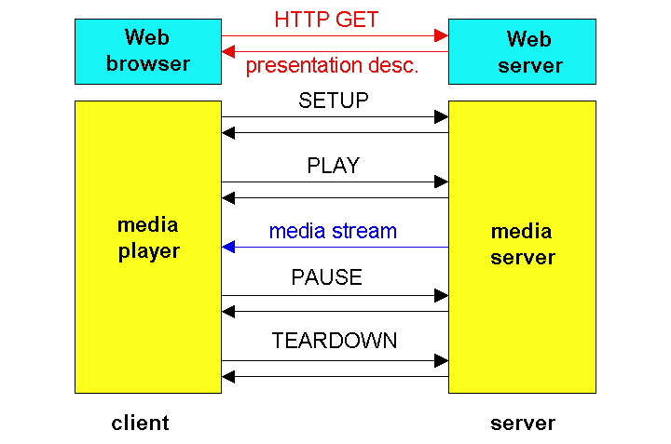
RTSP Operation
Multimedia Networking
7-<number>

Slide 121
RTSP Exchange Example
C: SETUP rtsp://audio.example.com/twister/audio RTSP/1.0
Transport: rtp/udp; compression; port=3056; mode=PLAY
S: RTSP/1.0 200 1 OK
Session 4231
C: PLAY rtsp://audio.example.com/twister/audio.en/lofi RTSP/1.0
Session: 4231
Range: npt=0-
C: PAUSE rtsp://audio.example.com/twister/audio.en/lofi RTSP/1.0
Session: 4231
Range: npt=37
C: TEARDOWN rtsp://audio.example.com/twister/audio.en/lofi RTSP/1.0
Session: 4231
S: 200 3 OK
Multimedia Networking
7-<number>

Slide 122
Conclusion
RTP usage – in several application audio and video tools (vat, vic)
RTP follows the principle of application level framing and integrated layer processing
RTP/UDP/IP is being used by the current streaming session protocols such as RTSP
Session protocols are actually negotiation/session establishment protocols that assist multimedia applications
Multimedia applications such as QuickTime, Real Player and others use them
CS 414 - Spring 2011

Slide 123
Internet Protocols
Existing Protocols
    TCP - reliable transport protocol
    UDP - unreliable transport protocol
    IP - Internet Network Protocol
    IMCP - Internet Message Control Protocol
New Protocols
    IPng - IP next generation (IP version 6)
    RTP - Real-time transport Protocol
    RSVP - resource reservation Protocol
    RTSP
Multimedia Networking

Slide 124
Multicasting
  Most current networks provide only unicast
    point-to-point connectivity
    replicated unicast - partial solution
      if one wants to reach multiple receivers
    Multicast - better solution
      current IP already provides this via MBONE routers that are multicast routers
Multimedia Networking

Slide 125
Internet Group Management Protocol
  Protocol for managing Internet multicast groups
  Host membership query messages
    sent by multicast routers to refresh their knowledge of memberships present on a network.
  Host membership reports
    sent by hosts in response to a query. Either individual group or host can respond.
  Queries are sent infrequently
    to keep IGMP protocol overhead low
  For multimedia
    IGMP must cooperate with resource management protocols such as RSVP to provide resource reservation.
Multimedia Networking

Slide 126
Real-time Transport Protocol (RTP)
  RTP provides end-to-end transport functions
      suitable for applications transmitting real-time data over multicast or unicast network services, e.g. multiparty multimedia conferences.
    Companion protocol - RTCP (Real-time Control protocol)
      conveys information about participants of a conference
    RTP functions
      determination of media encoding, synchronization, framing, error detection, encryption, timing and source identification
    RTCP function
      to monitor QoS and convey participant information.
      QoS monitor used to estimate current QoS, fault diagnosis, long-term statistics.
Multimedia Networking

Slide 127
RTP
  RTP does not do resource reservation or guarantee QoS for real-time applications
      relies on lower layers for real-time guarantees
      header carries sequence number for sequencing.
  Uses services of transport protocol - UDP/IP, ST-II etc.
    Provides application level framing and integrated layer processing
    RTP works with Profile that
      defines a set of payload type codes and their mapping to payload formats.
    Usage of RTP
      in video and audio tools (vat, nv)
      nv is a packet video program - supports network I/O for visual interaction in tele-conferencing over the Mbone.
Multimedia Networking

Slide 128
Other RTP Services
  RTP Services
      Payload Type Identification
      Sequence Numbering
      Timestamping
      Delivery Monitoring
  Other Services
    Mixer Service
      allows for resynchronization of incoming audio packets
      reconstructs the constant 20ms spacing generated by sender
      mixes the reconstructed audio streams into a single stream
      translates the audio encoding to a lower bandwidth
      forwards the lower bandwidth packet stream
    Translator Service
      allows for translation between IP and other high-speed protocols (e.g. ST-II and IP)
      translators may change the encoding of data
Multimedia Networking

Slide 129
IPng - new Internet Protocol
  IPng is IP version 6
    will replace the current IP version 4
  New Features
    new addressing and routing
      large hierarchical addresses (cluster addresses which allow policy route selection)
      multicast addresses carrying addresses of other Internet protocol suites
    more options for flow control and security
      allows for real-time flows, end-to-end security, provider selection
    host mobility
    auto-configuration/auto-reconfiguration
Multimedia Networking

Slide 130
IPng - Routing and Addressing
  Designed to run over high-speed (ATM) networks as well as work with low bandwidth (wireless network)
  Supports clusters, unicast and multicast
    Multicast addresses must specify scope
    Cluster addresses specify topological regions rather than individual nodes
  Hierarchical routing tables are required
  Each RTP flow can be labeled with QoS
    real-time services allow this.
Multimedia Networking

Slide 131
Integrated Services
  Classes of Service
    Datagram Service
    Controlled Load Service
      Performance as good as in an unloaded datagram network. No quantitative assurances.
    Guaranteed Service
      Firm bound on delay/throughput provided by every element along path
  Flow Specification
      Flow Spec = Traffic Spec + QoS Spec
      Traffic Spec - Peak rate, bucket rate, bucket size, max datagram size, min policed unit
      QoS Spec (for guaranteed service) - Rate, delay slack
Multimedia Networking

Slide 132
IS Capable Router
Routing Process
Reservation
Process
Policy Control
Admission Control
Packet
Classifier
Packet Scheduler
Multimedia Networking

Slide 133
RSVP - Resource ReSerVation Protocol
  Reservation
      specifies the amount of resources to be reserved for all or some subset of packets in a particular session.
      Implies adding a notion of flow spec (resource quantity) to intermediate nodes - parameterizes packet scheduling
      Filter spec - specifies the packet subset to receive the resources
    RSVP is a setup protocol of MM flows
      Senders multicast their data flows
      Senders periodically transmit path that includes a flow specification describing their flows.
      Receivers tune to appropriate multicast group and look for path messages. Based on path messages, receiver decides what part of senders flow to receive. Receiver generates a reservation message, which contains filter and flow specification for each senders flow.
Multimedia Networking

Slide 134
RSVP
  Purpose of filters
      provide support for heterogeneity - Receivers at the end of slow links can still participate in flows by using a filter to restrict what portion of a flow is passed to it.
      Dynamic filtering allows receivers to modify flow properties. Also useful when receiver is listening to multiple flows where filter can dynamically change which flows it is listening to.
      Reduce load and improve bandwidth management
  Three types of filters
    No filter (wildcard) mode - senders flow is not filtered
    Fixed filter mode
      senders flow is filtered according to fixed filter during reservation.
    Dynamic filter mode (Shared explicit)
      receiver can change the filter specification during the reservation.
Multimedia Networking

Slide 135
RSVP
  Reservations are Receiver oriented
      sender starts but receivers perform reservations - support for heterogeneity of receivers
  RSVP uses soft state to maintain information about reservation.
    Soft state
      information that is periodically refreshed by interested parties.
    In RSVP, senders and receivers refresh state at routers.
      Senders are required to periodically retransmit path messages to allow new receivers to learn of the flow, remind routers that the flow exists, and to adapt to routing changes.
      Receivers periodically retransmit their reservation messages to remind routers of their reservation.
Multimedia Networking

Slide 136
RTSP (Real-time Streaming Protocol)
  Source -Internet Draft, Feb 1998
  Application level protocol
    for control over delivery of data with real-time properties
    Provides extensible framework to enable controlled, on-demand delivery of real-time data such as audio/video
      establishes and controls either a single or several time-synchronized streams of continuous media
    Sources - both live data feeds and stored clips
    can control multiple data delivery sessions
      provide means for choosing delivery channels such as UDP, multicast UDP and TCP and provide a means for choosing delivery mechanisms
    does not deliver media, acts a network remote control for servers.
Multimedia Networking

Slide 137
RTSP
  RTSP Session
    No notion of a RTSP connection server maintains a session labeled by an identifier that is in no way connected to a transport level connection such as a TCP connection.
    During an RTSP session, an RTSP client may open and close many connections to the server to issue RTSP requests.
  RTSP protocol
    works between an RTSP server and client
      server maintains state by default in almost all cases.
      Both RTSP server and client can issue a request.
Multimedia Networking

Slide 138
RTSP Operations
  Basic RTSP Control Requests
      SETUP, PLAY, RECORD, PAUSE and TEARDOWN
    Retrieval of media from media server
      Client requests a presentation description. If presentation is being multicast, presentation description contains the multicast addresses and ports for continuous media. For unicast, client provides the destination for security reasons.
    Invitation of a media server to a conference
      media server invited to join an existing conference to playback media into the presentation or to record all or a subset of the media in a presentation.
    Addition of media to an existing presentation
      Useful for live presentation where server can tell the client about additional media becoming available
Multimedia Networking

Slide 139
Outline
Multimedia networking applications
Requirements for Multimedia Communication
    User and application requirements
    Processing and protocol constraints
    Mapping to OSI layers
Network QoS and Resource Management
  Providing multiple classes of service
  Negotiation, Translation, Admission
  Traffic Shaping, Rate Control, Error Control
  Monitoring, Adaptation
MM over Internet
  Protocols for real-time interactive applications (RTP,RTCP,SIP)
Other Case Studies
    Fast Ethernet, FDDI, DQDB, ATM
Multimedia Networking
7-<number>

Slide 140

Multimedia Over Today’s Internet
TCP/UDP/IP: “best-effort service”
no guarantees on delay, loss
?
?
?
?
?
?
But you said multimedia apps requires
QoS and level of performance to be
effective!
?
?
?
?
?
Today’s Internet multimedia applications
use application-level techniques to mitigate
(as best possible) effects of delay, loss
Multimedia Networking
7-<number>

Slide 141
Chapter 7 outline
7.1 multimedia networking applications
7.2 streaming stored audio and video
7.3 making the best out of best effort service
7.4 protocols for real-time interactive applications
  RTP,RTCP,SIP
7.5 providing multiple classes of service
7.6 providing QoS guarantees
Multimedia Networking
7-<number>

Slide 142
Real-time interactive applications
PC-2-PC phone
  Skype
PC-2-phone
  Dialpad
  Net2phone
  Skype
videoconference with webcams
  Skype
  Polycom
Going to now look at a PC-2-PC Internet phone example in detail
Multimedia Networking
7-<number>

Slide 143
Interactive Multimedia: Internet Phone
Introduce Internet Phone by way of an example
speaker’s audio: alternating talk spurts, silent periods.
  64 kbps during talk spurt
  pkts generated only during talk spurts
  20 msec chunks at 8 Kbytes/sec: 160 bytes data
application-layer header added to each chunk.
chunk+header encapsulated into UDP segment.
application sends UDP segment into socket every 20 msec during talkspurt
Multimedia Networking
7-<number>

Slide 144
Internet Phone: Packet Loss and Delay
network loss: IP datagram lost due to network congestion (router buffer overflow)
delay loss: IP datagram arrives too late for playout at receiver
  delays: processing, queueing in network; end-system (sender, receiver) delays
  typical maximum tolerable delay: 400 ms
loss tolerance: depending on voice encoding, losses concealed, packet loss rates between 1% and 10% can be tolerated.
Multimedia Networking
7-<number>

Slide 145
Delay Jitter
constant bit
rate
transmission
client
reception
constant bit
rate playout
at client
Cumulative data
variable
network
delay
(jitter)
buffered
data
client playout
delay
time
consider end-to-end delays of two consecutive packets: difference can be more or less than 20 msec (transmission time difference)
Multimedia Networking
7-<number>

Slide 146
Internet Phone: Fixed Playout Delay
receiver attempts to playout each chunk exactly q msecs after chunk was generated.
  chunk has time stamp t: play out chunk at t+q .
  chunk arrives after t+q: data arrives too late for playout, data “lost”
tradeoff in choosing q:
  large q: less packet loss
  small q: better interactive experience
Multimedia Networking
7-<number>

Slide 147
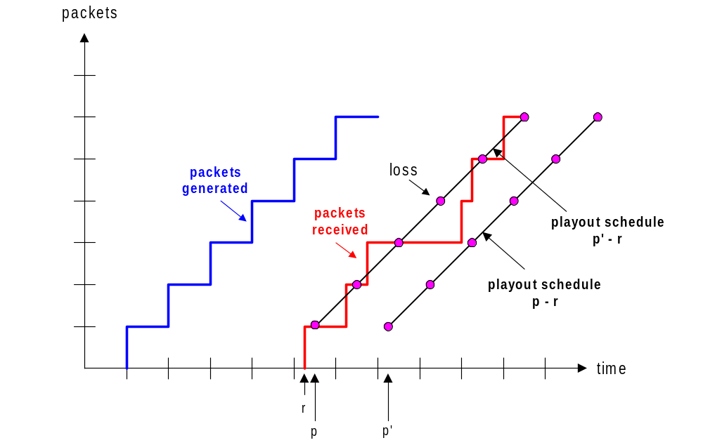
Fixed Playout Delay
sender generates packets every 20 msec during talk spurt.
first packet received at time r
first playout schedule: begins at p
second playout schedule: begins at p’
Multimedia Networking
7-<number>

Slide 148
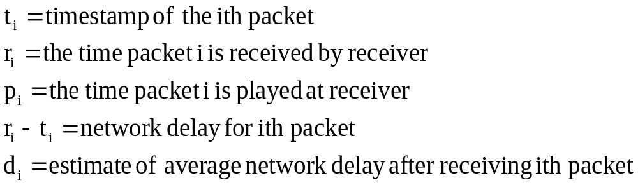

Adaptive Playout Delay (1)
Goal: minimize playout delay, keeping late loss rate low
Approach: adaptive playout delay adjustment:
  estimate network delay, adjust playout delay at beginning of each talk spurt.
  silent periods compressed and elongated.
  chunks still played out every 20 msec during talk spurt.
dynamic estimate of average delay at receiver:
where u is a fixed constant (e.g., u = .01).
Multimedia Networking
7-<number>

Slide 149


Adaptive playout delay (2)
also useful to estimate average deviation of delay, v_{i} :
estimates d_{i} , v_{i} calculated for every received packet
(but used only at start of talk spurt
for first packet in talk spurt, playout time is:
where K is positive constant
remaining packets in talkspurt are played out periodically
Multimedia Networking
7-<number>

Slide 150
Adaptive Playout (3)
Q: How does receiver determine whether packet is first in a talkspurt?
if no loss, receiver looks at successive timestamps.
  difference of successive stamps > 20 msec -->talk spurt begins.
with loss possible, receiver must look at both time stamps and sequence numbers.
  difference of successive stamps > 20 msec and sequence numbers without gaps --> talk spurt begins.
Multimedia Networking
7-<number>

Slide 151
Recovery from packet loss (1)
Forward Error Correction (FEC): simple scheme
for every group of n chunks create redundant chunk by exclusive OR-ing n original chunks
send out n+1 chunks, increasing bandwidth by factor 1/n.
can reconstruct original n chunks if at most one lost chunk from n+1 chunks
playout delay: enough time to receive all n+1 packets
tradeoff:
  increase n, less bandwidth waste
  increase n, longer playout delay
  increase n, higher probability that 2 or more chunks will be lost
Multimedia Networking
7-<number>

Slide 152
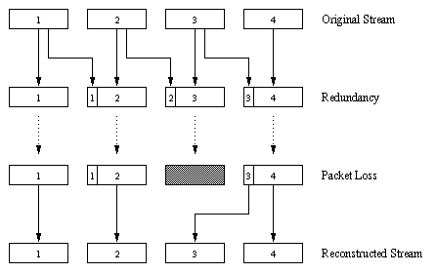
Recovery from packet loss (2)
2nd FEC scheme
“piggyback lower
quality stream”
send lower resolution
audio stream as
redundant information
e.g., nominal
stream PCM at 64 kbps
and redundant stream
GSM at 13 kbps.
whenever there is non-consecutive loss,
receiver can conceal the loss.
can also append (n-1)st and (n-2)nd low-bit rate
chunk
Multimedia Networking
7-<number>

Slide 153
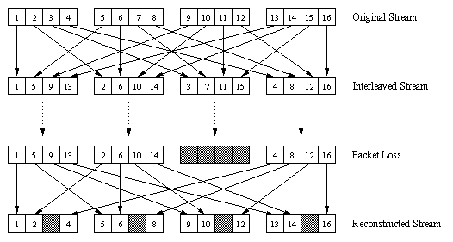
Recovery from packet loss (3)
Interleaving
chunks divided into smaller units
for example, four 5 msec units per chunk
packet contains small units from different chunks
if packet lost, still have most of every chunk
no redundancy overhead, but increases playout delay
Multimedia Networking
7-<number>

Slide 154
Content distribution networks (CDNs)
Content replication
challenging to stream large files (e.g., video) from single origin server in real time
solution: replicate content at hundreds of servers throughout Internet
  content downloaded to CDN servers ahead of time
  placing content “close” to user avoids impairments (loss, delay) of sending content over long paths
  CDN server typically in edge/access network
origin server
in North America
CDN distribution node
CDN server
in S. America
CDN server
in Asia
CDN server
in Europe
Multimedia Networking
7-<number>

Slide 155
Content distribution networks (CDNs)
Content replication
CDN (e.g., Akamai) customer is the content provider (e.g., CNN)
CDN replicates customers’ content in CDN servers.
when provider updates content, CDN updates servers
origin server
in North America
CDN distribution node
CDN server
in S. America
CDN server
in Asia
CDN server
in Europe
Multimedia Networking
7-<number>

Slide 156
CDN example
HTTP request for
www.foo.com/sports/sports.html
origin server
1
2
DNS query for www.cdn.com
client
CDN’s authoritative
DNS server
3
HTTP request for
www.cdn.com/www.foo.com/sports/ruth.gif
CDN server near client
origin server (www.foo.com)
distributes HTML
replaces:
http://www.foo.com/sports.ruth.gif
with http://www.cdn.com/www.foo.com/sports/ruth.gif
CDN company (cdn.com)
distributes gif files
uses its authoritative DNS server to route redirect requests
Multimedia Networking
7-<number>

Slide 157
More about CDNs
routing requests
CDN creates a “map”, indicating distances from leaf ISPs and CDN nodes
when query arrives at authoritative DNS server:
  server determines ISP from which query originates
  uses “map” to determine best CDN server
CDN nodes create application-layer overlay network
Multimedia Networking
7-<number>

Slide 158
Summary: Internet Multimedia: bag of tricks
use UDP to avoid TCP congestion control (delays) for time-sensitive traffic
client-side adaptive playout delay: to compensate for delay
server side matches stream bandwidth to available client-to-server path bandwidth
  chose among pre-encoded stream rates
  dynamic server encoding rate
error recovery (on top of UDP)
  FEC, interleaving, error concealment
  retransmissions, time permitting
CDN: bring content closer to clients
Multimedia Networking
7-<number>

Slide 159
Chapter 7 outline
7.1 multimedia networking applications
7.2 streaming stored audio and video
7.3 making the best out of best effort service
7.4 protocols for real-time interactive applications
  RTP, RTCP, SIP
7.5 providing multiple classes of service
7.6 providing QoS guarantees
Multimedia Networking
7-<number>

Slide 160
Real-Time Protocol (RTP)
RTP specifies packet structure for packets carrying audio, video data
RFC 3550
RTP packet provides
  payload type identification
  packet sequence numbering
  time stamping
RTP runs in end systems
RTP packets encapsulated in UDP segments
interoperability: if two Internet phone applications run RTP, then they may be able to work together
Multimedia Networking
7-<number>

Slide 161
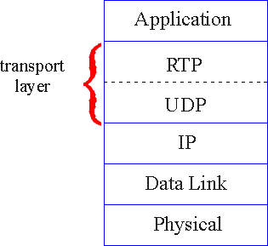
RTP runs on top of UDP
RTP libraries provide transport-layer interface
that extends UDP:
  port numbers, IP addresses
  payload type identification
  packet sequence numbering
  time-stamping
Multimedia Networking
7-<number>

Slide 162
RTP Example
consider sending 64 kbps PCM-encoded voice over RTP.
application collects encoded data in chunks, e.g., every 20 msec = 160 bytes in a chunk.
audio chunk + RTP header form RTP packet, which is encapsulated in UDP segment
RTP header indicates type of audio encoding in each packet
  sender can change encoding during conference.
RTP header also contains sequence numbers, timestamps.
Multimedia Networking
7-<number>

Slide 163
RTP and QoS
RTP does not provide any mechanism to ensure timely data delivery or other QoS guarantees.
RTP encapsulation is only seen at end systems (not) by intermediate routers.
  routers providing best-effort service, making no special effort to ensure that RTP packets arrive at destination in timely matter.
Multimedia Networking
7-<number>

Slide 164

RTP Header
Payload Type (7 bits): Indicates type of encoding currently being
used. If sender changes encoding in middle of conference, sender
informs receiver via payload type field.
  Payload type 0: PCM mu-law, 64 kbps
  Payload type 3, GSM, 13 kbps
  Payload type 7, LPC, 2.4 kbps
  Payload type 26, Motion JPEG
  Payload type 31. H.261
  Payload type 33, MPEG2 video
Sequence Number (16 bits): Increments by one for each RTP packet
sent, and may be used to detect packet loss and to restore packet
sequence.
Multimedia Networking
7-<number>

Slide 165
RTP Header (2)
Timestamp field (32 bytes long): sampling instant of first byte in this RTP data packet
  for audio, timestamp clock typically increments by one for each sampling period (for example, each 125 usecs for 8 KHz sampling clock)
  if application generates chunks of 160 encoded samples, then timestamp increases by 160 for each RTP packet when source is active. Timestamp clock continues to increase at constant rate when source is inactive.
SSRC field (32 bits long): identifies source of t RTP stream. Each stream in RTP session should have distinct SSRC.
Multimedia Networking
7-<number>

Slide 166
RTSP/RTP Programming Assignment
build a server that encapsulates stored video frames into RTP packets
  grab video frame, add RTP headers, create UDP segments, send segments to UDP socket
  include seq numbers and time stamps
  client RTP provided for you
also write client side of RTSP
  issue play/pause commands
  server RTSP provided for you
Multimedia Networking
7-<number>

Slide 167
Real-Time Control Protocol (RTCP)
works in conjunction with RTP.
each participant in RTP session periodically transmits RTCP control packets to all other participants.
each RTCP packet contains sender and/or receiver reports
  report statistics useful to application: # packets sent, # packets lost, interarrival jitter, etc.
feedback can be used to control performance
  sender may modify its transmissions based on feedback
Multimedia Networking
7-<number>

Slide 168
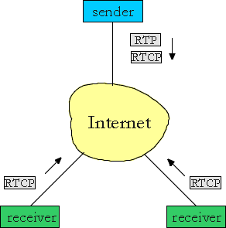
RTCP - Continued
each RTP session: typically a single multicast address; all RTP /RTCP packets belonging to session use multicast address.
RTP, RTCP packets distinguished from each other via distinct port numbers.
to limit traffic, each participant reduces RTCP traffic as number of conference participants increases
Multimedia Networking
7-<number>

Slide 169
RTCP Packets
Receiver report packets:
fraction of packets lost, last sequence number, average interarrival jitter
Sender report packets:
SSRC of RTP stream, current time, number of packets sent, number of bytes sent
Source description packets:
e-mail address of sender, sender's name, SSRC of associated RTP stream
provide mapping between the SSRC and the user/host name
Multimedia Networking
7-<number>

Slide 170
Synchronization of Streams
RTCP can synchronize different media streams within a RTP session
consider videoconferencing app for which each sender generates one RTP stream for video, one for audio.
timestamps in RTP packets tied to the video, audio sampling clocks
  not tied to wall-clock time
each RTCP sender-report packet contains (for most recently generated packet in associated RTP stream):
  timestamp of RTP packet
  wall-clock time for when packet was created.
receivers uses association to synchronize playout of audio, video
Multimedia Networking
7-<number>

Slide 171
RTCP Bandwidth Scaling
RTCP attempts to limit its traffic to 5% of session bandwidth.
Example
Suppose one sender, sending video at 2 Mbps. Then RTCP attempts to limit its traffic to 100 Kbps.
RTCP gives 75% of rate to receivers; remaining 25% to sender
75 kbps is equally shared among receivers:
  with R receivers, each receiver gets to send RTCP traffic at 75/R kbps.
sender gets to send RTCP traffic at 25 kbps.
participant determines RTCP packet transmission period by calculating avg RTCP packet size (across entire session) and dividing by allocated rate
Multimedia Networking
7-<number>

Slide 172
SIP: Session Initiation Protocol [RFC 3261]
SIP long-term vision:
all telephone calls, video conference calls take place over Internet
people are identified by names or e-mail addresses, rather than by phone numbers
you can reach callee, no matter where callee roams, no matter what IP device callee is currently using
Multimedia Networking
7-<number>

Slide 173
SIP Services
Setting up a call, SIP provides mechanisms ..
  for caller to let callee know she wants to establish a call
  so caller, callee can agree on media type, encoding
  to end call
determine current IP address of callee:
  maps mnemonic identifier to current IP address
call management:
  add new media streams during call
  change encoding during call
  invite others
  transfer, hold calls
Multimedia Networking
7-<number>

Slide 174
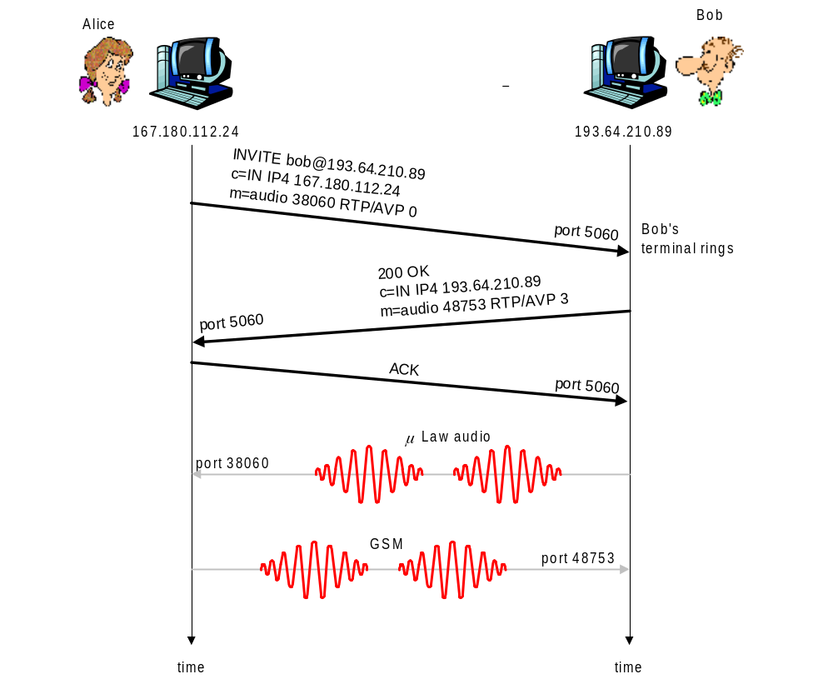
Setting up a call to known IP address
Alice’s SIP invite message indicates her port number, IP address, encoding she prefers to receive (PCM ulaw)
Bob’s 200 OK message indicates his port number, IP address, preferred encoding (GSM)
SIP messages can be sent over TCP or UDP; here sent over RTP/UDP.
default SIP port number is 5060.
Multimedia Networking
7-<number>

Slide 175
Setting up a call (more)
codec negotiation:
  suppose Bob doesn’t have PCM ulaw encoder.
  Bob will instead reply with 606 Not Acceptable Reply, listing his encoders Alice can then send new INVITE message, advertising different encoder
rejecting a call
  Bob can reject with replies “busy,” “gone,” “payment required,” “forbidden”
media can be sent over RTP or some other protocol
Multimedia Networking
7-<number>

Slide 176
Example of SIP message
INVITE sip:bob@domain.com SIP/2.0
Via: SIP/2.0/UDP 167.180.112.24
From: sip:alice@hereway.com
To: sip:bob@domain.com
Call-ID: a2e3a@pigeon.hereway.com
Content-Type: application/sdp
Content-Length: 885
c=IN IP4 167.180.112.24
m=audio 38060 RTP/AVP 0
Notes:
HTTP message syntax
sdp = session description protocol
Call-ID is unique for every call.
Here we don’t know Bob’s IP address.
  intermediate SIP
  servers needed.
Alice sends, receives SIP messages using SIP default port 506
Alice specifies in header that SIP client
sends, receives SIP messages over UDP
Multimedia Networking
7-<number>

Slide 177
Name translation and user location
caller wants to call callee, but only has callee’s name or e-mail address.
need to get IP address of callee’s current host:
  user moves around
  DHCP protocol
  user has different IP devices (PC, PDA, car device)
result can be based on:
  time of day (work, home)
  caller (don’t want boss to call you at home)
  status of callee (calls sent to voicemail when callee is already talking to someone)
Service provided by SIP servers:
SIP registrar server
SIP proxy server
Multimedia Networking
7-<number>

Slide 178
SIP Registrar
when Bob starts SIP client, client sends SIP REGISTER message to Bob’s registrar server
(similar function needed by Instant Messaging)
Register Message:
REGISTER sip:domain.com SIP/2.0
Via: SIP/2.0/UDP 193.64.210.89
From: sip:bob@domain.com
To: sip:bob@domain.com
Expires: 3600
Multimedia Networking
7-<number>

Slide 179
SIP Proxy
Alice sends invite message to her proxy server
  contains address sip:bob@domain.com
proxy responsible for routing SIP messages to callee
  possibly through multiple proxies.
callee sends response back through the same set of proxies.
proxy returns SIP response message to Alice
  contains Bob’s IP address
proxy analogous to local DNS server
Multimedia Networking
7-<number>

Slide 180
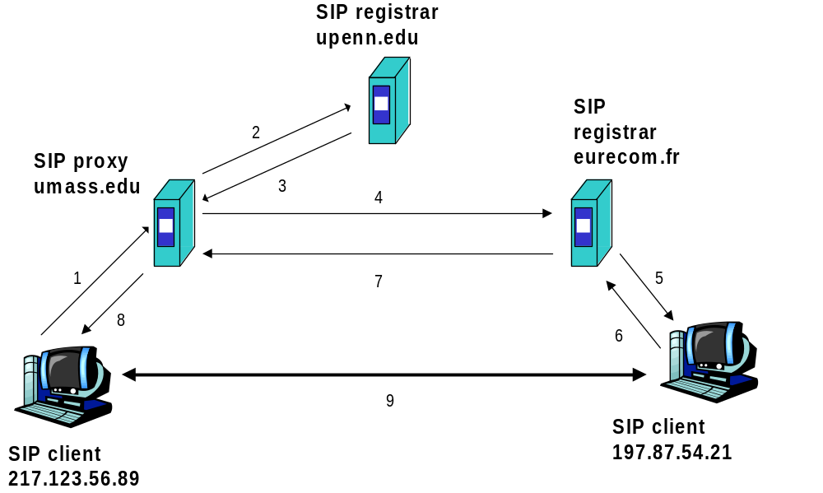
Example
Caller jim@umass.edu
with places a
call to keith@upenn.edu
(1) Jim sends INVITE
message to umass SIP
proxy. (2) Proxy forwards
request to upenn
registrar server.
(3) upenn server returns
redirect response,
indicating that it should
try keith@eurecom.fr
(4) umass proxy sends INVITE to eurecom registrar. (5) eurecom registrar forwards INVITE to 197.87.54.21, which is running keith’s SIP client. (6-8) SIP response sent back (9) media sent directly
between clients.
Note: also a SIP ack message, which is not shown.
Multimedia Networking
7-<number>

Slide 181
Comparison with H.323
H.323 is another signaling protocol for real-time, interactive
H.323 is a complete, vertically integrated suite of protocols for multimedia conferencing: signaling, registration, admission control, transport, codecs
SIP is a single component. Works with RTP, but does not mandate it. Can be combined with other protocols, services
H.323 comes from the ITU (telephony).
SIP comes from IETF: Borrows much of its concepts from HTTP
  SIP has Web flavor, whereas H.323 has telephony flavor.
SIP uses the KISS principle: Keep it simple stupid.
Multimedia Networking
7-<number>

Slide 182
Chapter 7 outline
7.1 multimedia networking applications
7.2 streaming stored audio and video
7.3 making the best out of best effort service
7.4 protocols for real-time interactive applications
  RTP, RTCP, SIP
7.5 providing multiple classes of service
7.6 providing QoS guarantees
Multimedia Networking
7-<number>

Slide 183
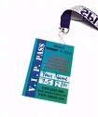
Providing Multiple Classes of Service
thus far: making the best of best effort service
  one-size fits all service model
alternative: multiple classes of service
  partition traffic into classes
  network treats different classes of traffic differently (analogy: VIP service vs regular service)
granularity: differential service among multiple classes, not among individual connections
history: ToS bits
0111
Multimedia Networking
7-<number>

Slide 184
Multiple classes of service: scenario
H1
H3
R1
R2
H4
H2
R1 output
interface
queue
1.5 Mbps link
Multimedia Networking
7-<number>

Slide 185
Scenario 1: mixed FTP and audio
Example: 1Mbps IP phone, FTP share 1.5 Mbps link.
  bursts of FTP can congest router, cause audio loss
  want to give priority to audio over FTP
R1
R2
Principle 1
packet marking needed for router to distinguish between different classes; and new router policy to treat packets accordingly
Multimedia Networking
7-<number>

Slide 186
Principles for QOS Guarantees (more)
what if applications misbehave (audio sends higher than declared rate)
  policing: force source adherence to bandwidth allocations
marking and policing at network edge:
  similar to ATM UNI (User Network Interface)
1 Mbps
phone
R1
R2
1.5 Mbps link
packet marking and policing
Principle 2
provide protection (isolation) for one class from others
Multimedia Networking
7-<number>

Slide 187
Principles for QOS Guarantees (more)
Allocating fixed (non-sharable) bandwidth to flow: inefficient use of bandwidth if flows doesn’t use its allocation
1 Mbps
phone
1 Mbps logical link
R1
R2
1.5 Mbps link
0.5 Mbps logical link
Principle 3
While providing isolation, it is desirable to use
resources as efficiently as possible
Multimedia Networking
7-<number>

Slide 188
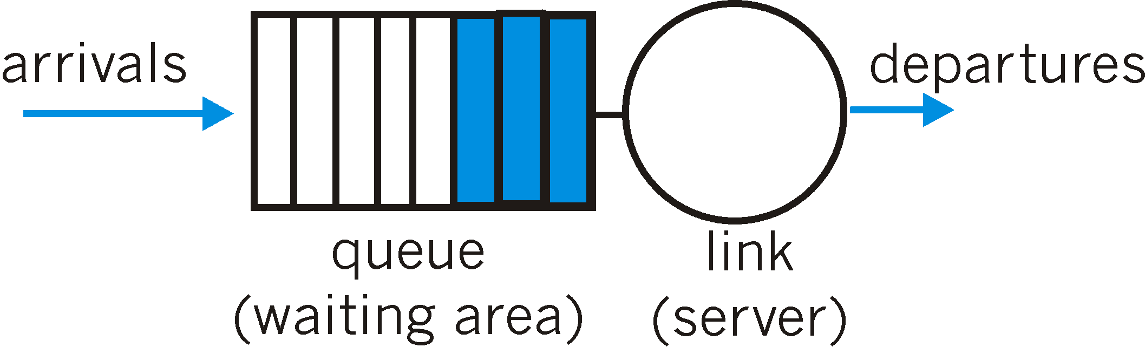
Scheduling And Policing Mechanisms
scheduling: choose next packet to send on link
FIFO (first in first out) scheduling: send in order of arrival to queue
  real-world example?
  discard policy: if packet arrives to full queue: who to discard?
    Tail drop: drop arriving packet
    priority: drop/remove on priority basis
    random: drop/remove randomly
Multimedia Networking
7-<number>

Slide 189
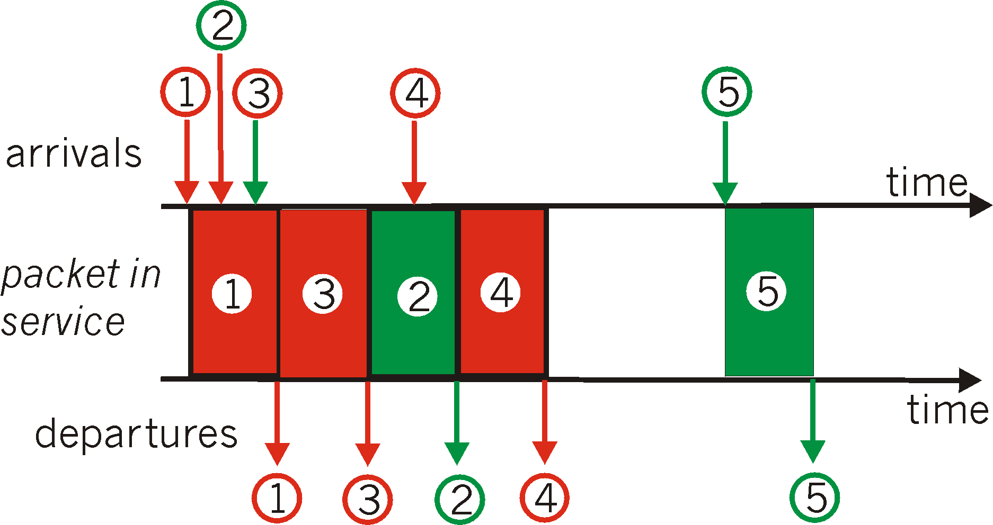
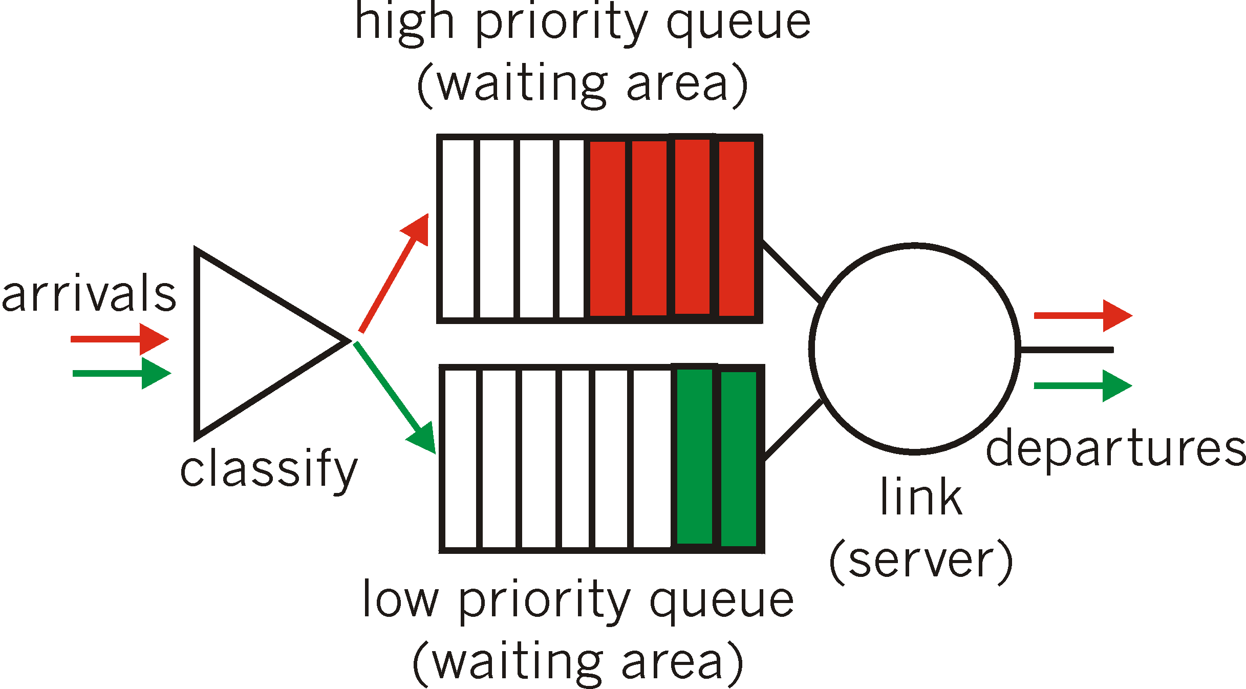
Scheduling Policies: more
Priority scheduling: transmit highest priority queued packet
multiple classes, with different priorities
  class may depend on marking or other header info, e.g. IP source/dest, port numbers, etc..
  Real world example?
Multimedia Networking
7-<number>

Slide 190
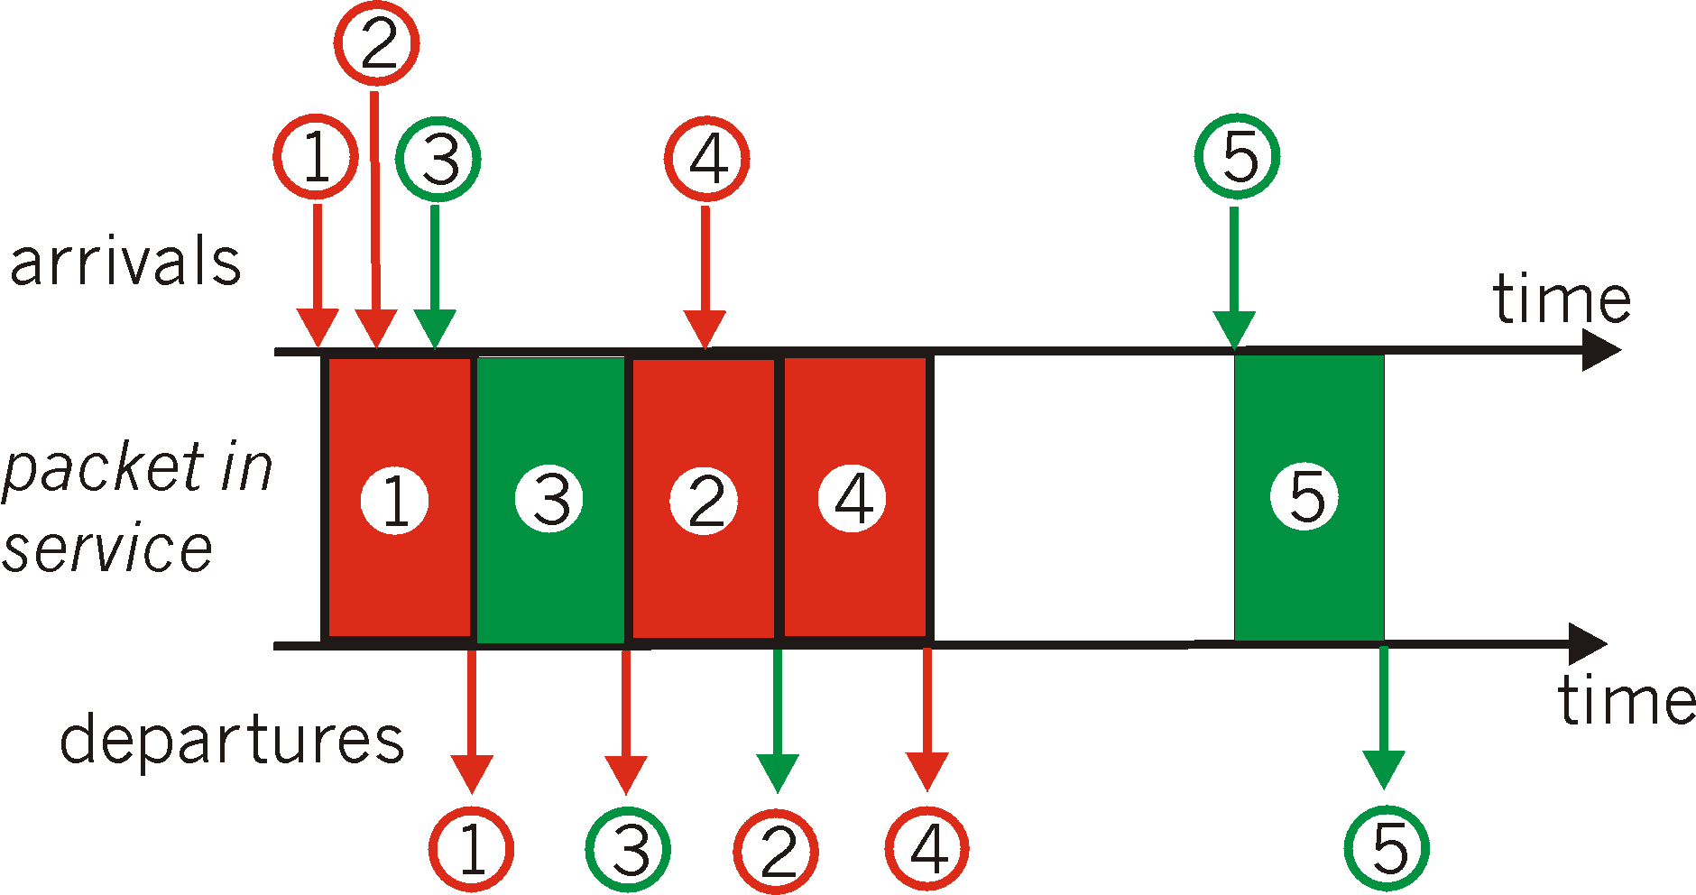
Scheduling Policies: still more
round robin scheduling:
multiple classes
cyclically scan class queues, serving one from each class (if available)
real world example?
Multimedia Networking
7-<number>

Slide 191
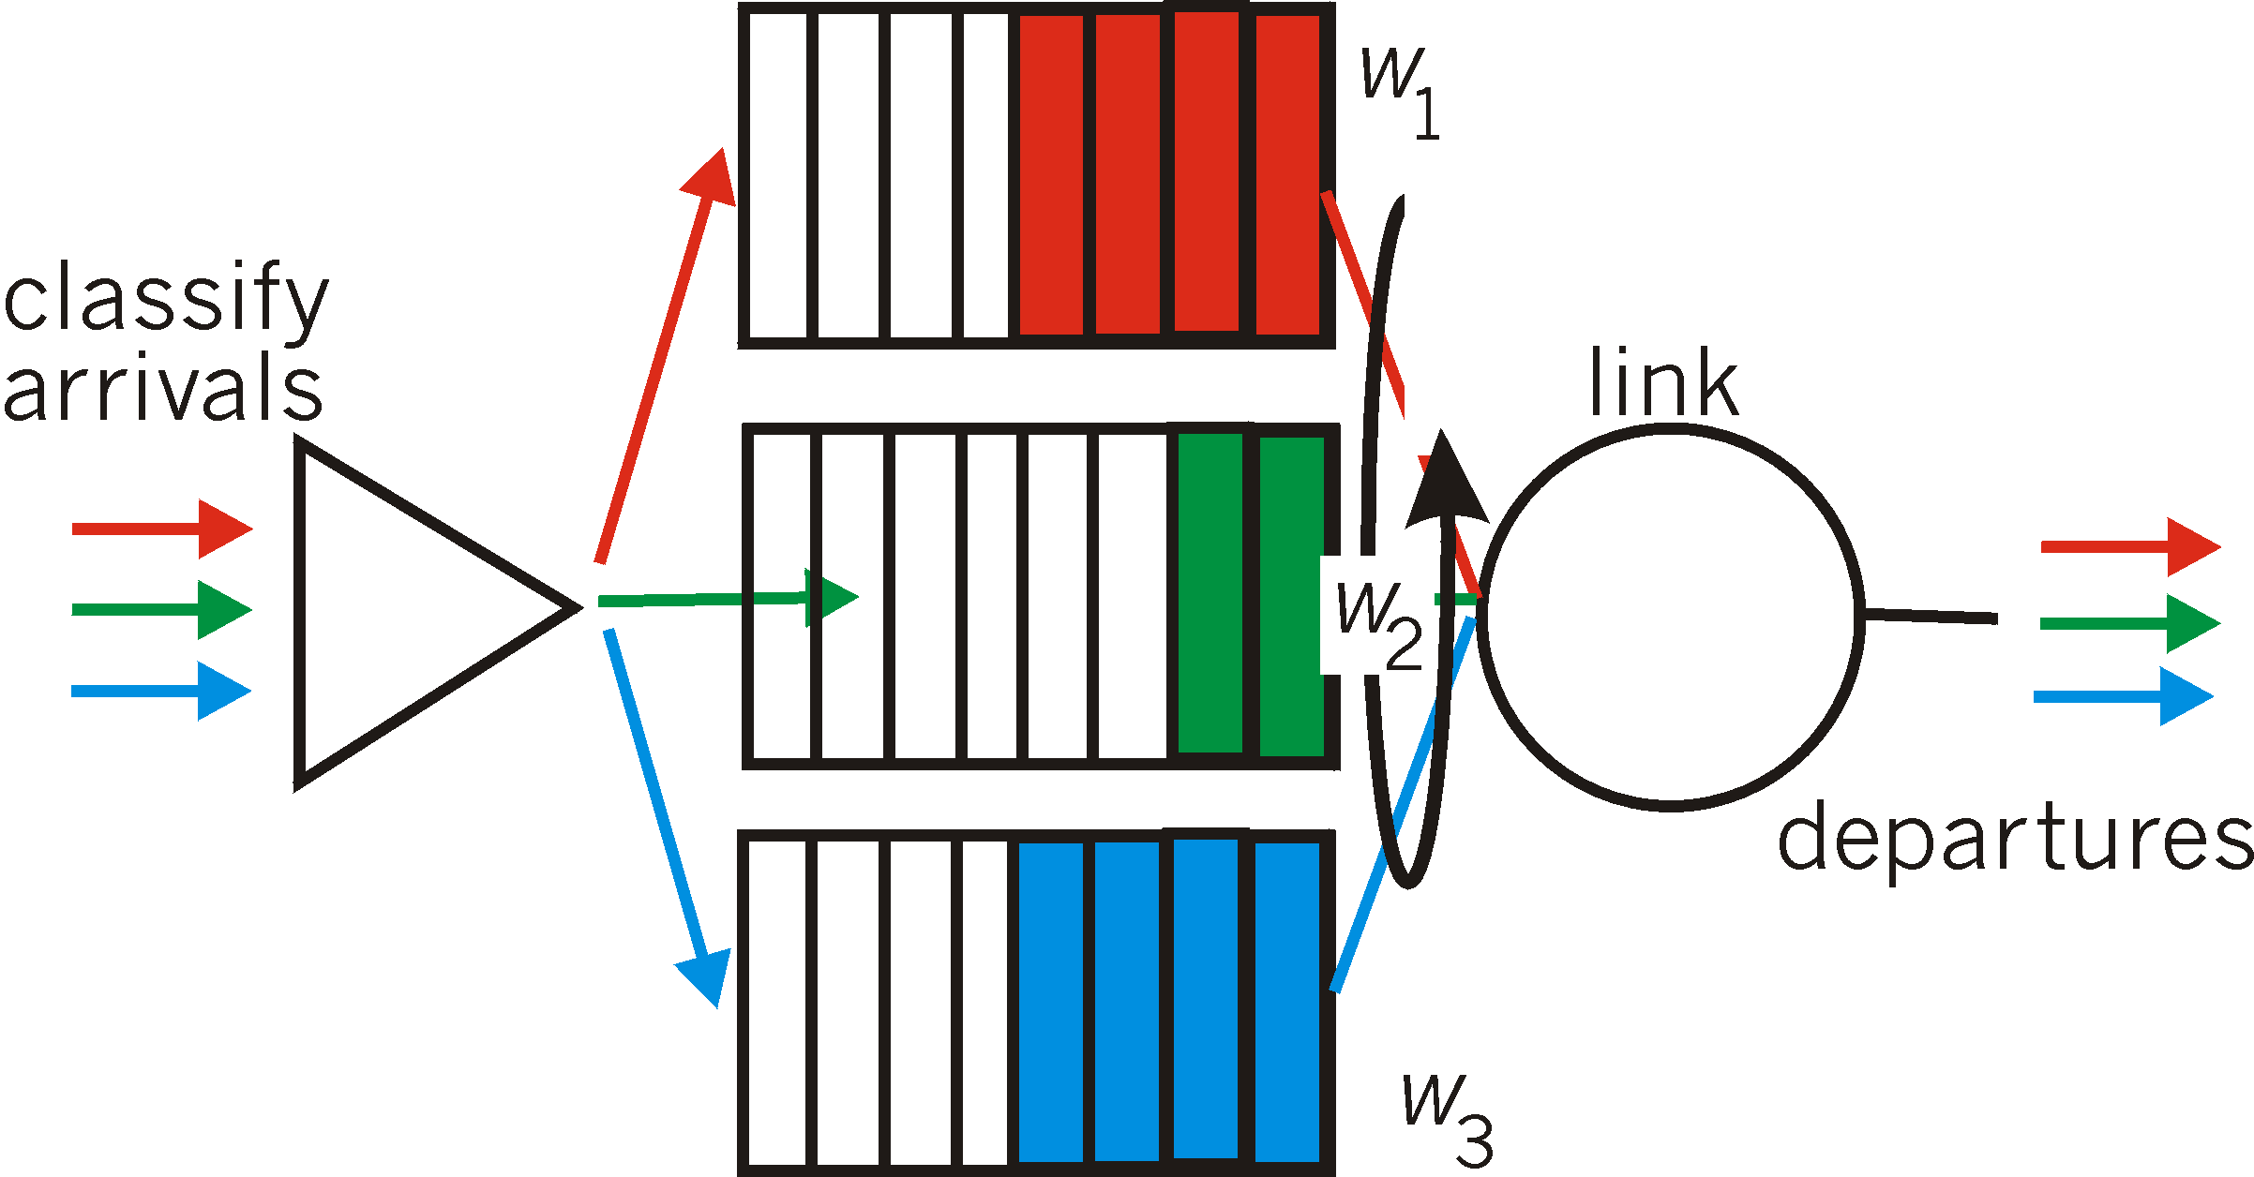
Scheduling Policies: still more
Weighted Fair Queuing:
generalized Round Robin
each class gets weighted amount of service in each cycle
real-world example?
Multimedia Networking
7-<number>

Slide 192
Policing Mechanisms
Goal: limit traffic to not exceed declared parameters
Three common-used criteria:
(Long term) Average Rate: how many pkts can be sent per unit time (in the long run)
  crucial question: what is the interval length: 100 packets per sec or 6000 packets per min have same average!
Peak Rate: e.g., 6000 pkts per min. (ppm) avg.; 1500 ppm peak rate
(Max.) Burst Size: max. number of pkts sent consecutively (with no intervening idle)
Multimedia Networking
7-<number>

Slide 193
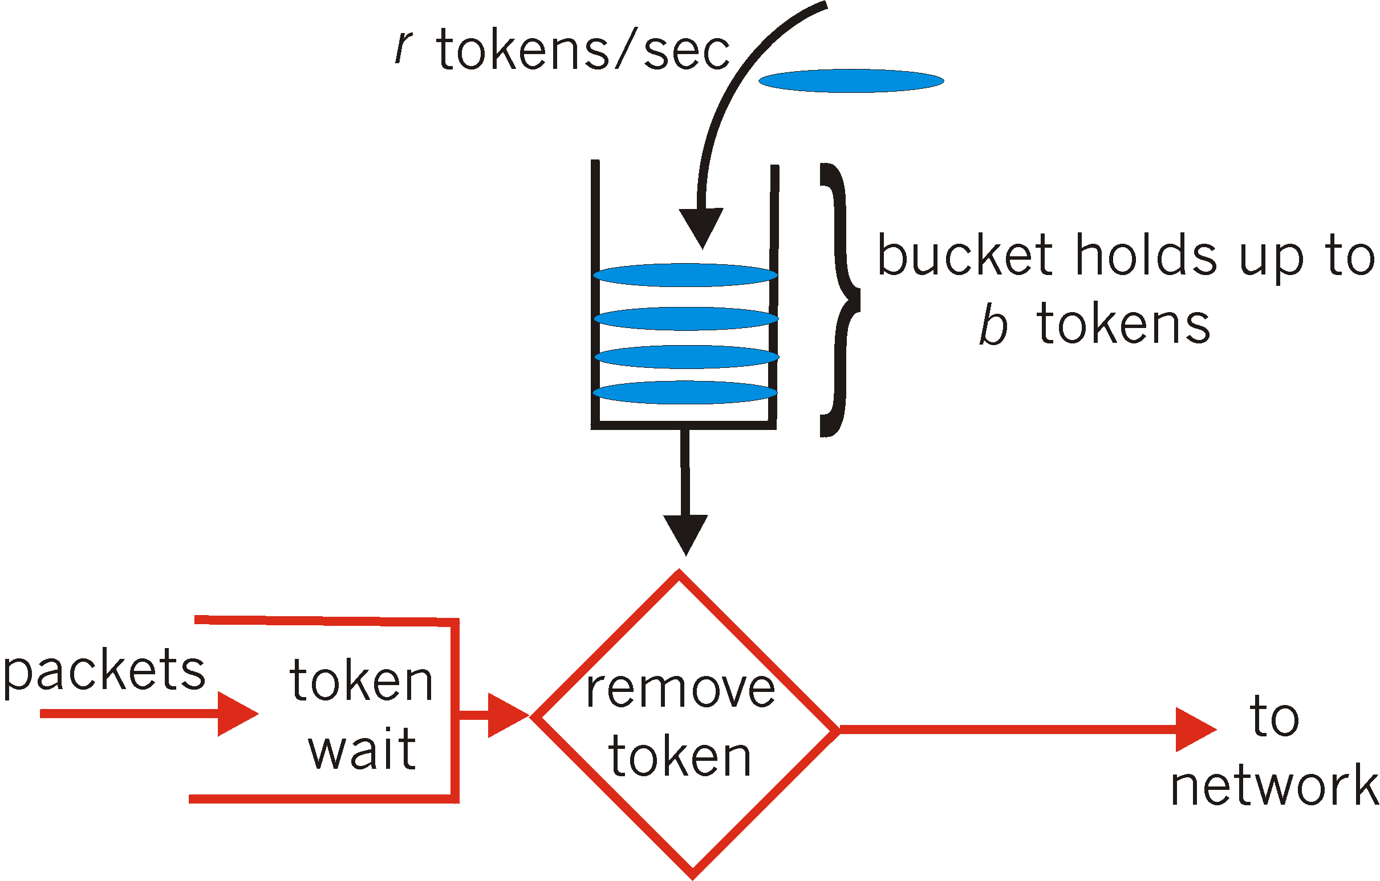
Policing Mechanisms
Token Bucket: limit input to specified Burst Size and Average Rate.
bucket can hold b tokens
tokens generated at rate r token/sec unless bucket full
over interval of length t: number of packets admitted less than or equal to (r t + b).
Multimedia Networking
7-<number>

Slide 194
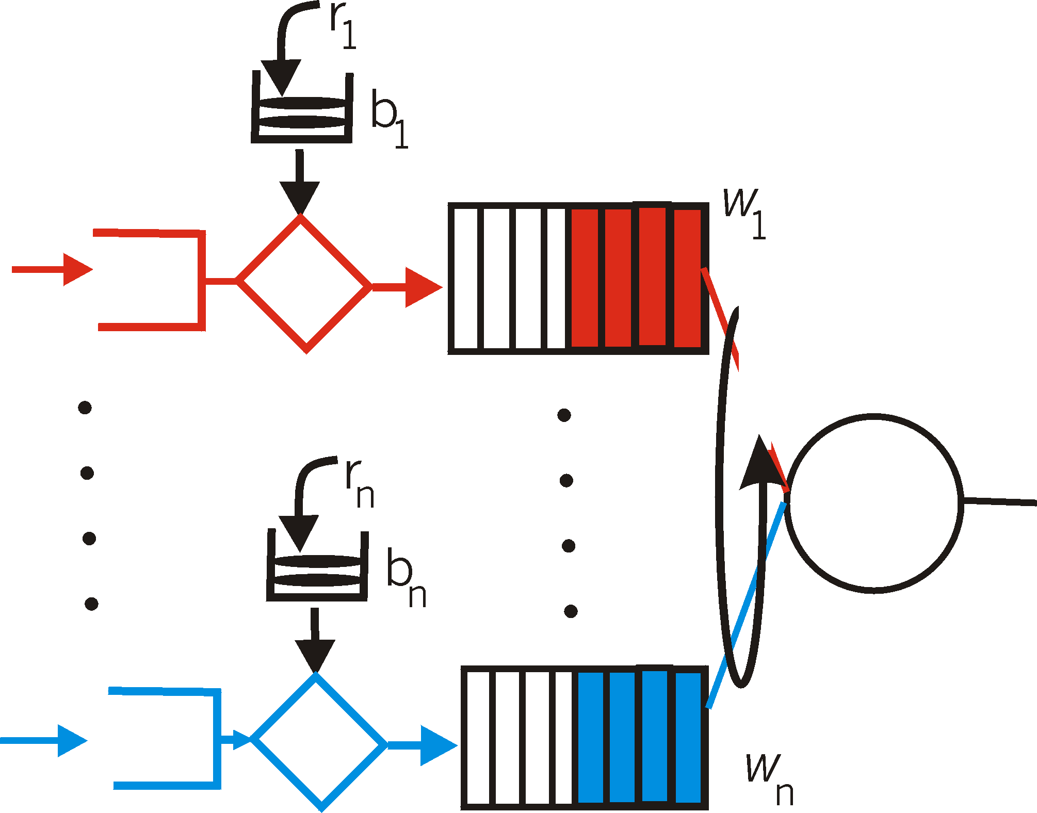
Policing Mechanisms (more)
token bucket, WFQ combine to provide guaranteed upper bound on delay, i.e., QoS guarantee!
arriving
traffic
token rate, r
bucket size, b
per-flow
rate, R
WFQ
D = b/R
max
Multimedia Networking
7-<number>

Slide 195
IETF Differentiated Services
want “qualitative” service classes
  “behaves like a wire”
  relative service distinction: Platinum, Gold, Silver
scalability: simple functions in network core, relatively complex functions at edge routers (or hosts)
  signaling, maintaining per-flow router state difficult with large number of flows
don’t define define service classes, provide functional components to build service classes
Multimedia Networking
7-<number>

Slide 196

Diffserv Architecture
Edge router:
per-flow traffic management
marks packets as in-profile and out-profile
marking
r
scheduling
.
b
.
.
Core router:
per class traffic management
buffering and scheduling based on marking at edge
preference given to in-profile packets
Multimedia Networking
7-<number>

Slide 197
Edge-router Packet Marking
profile: pre-negotiated rate A, bucket size B
packet marking at edge based on per-flow profile
Rate A
B
User packets
Possible usage of marking:
class-based marking: packets of different classes marked differently
intra-class marking: conforming portion of flow marked differently than non-conforming one
Multimedia Networking
7-<number>

Slide 198

Classification and Conditioning
Packet is marked in the Type of Service (TOS) in IPv4, and Traffic Class in IPv6
6 bits used for Differentiated Service Code Point (DSCP) and determine PHB that the packet will receive
2 bits are currently unused
Multimedia Networking
7-<number>

Slide 199
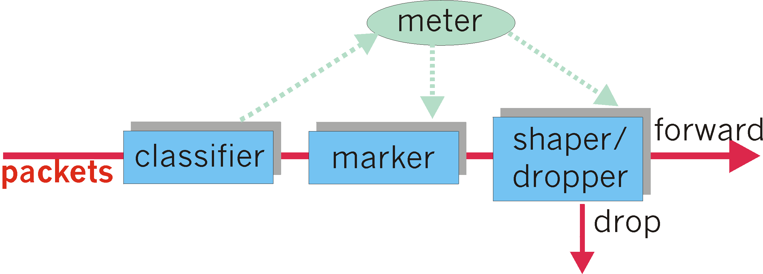
Classification and Conditioning
may be desirable to limit traffic injection rate of some class:
user declares traffic profile (e.g., rate, burst size)
traffic metered, shaped if non-conforming
Multimedia Networking
7-<number>

Slide 200
Forwarding (PHB)
PHB result in a different observable (measurable) forwarding performance behavior
PHB does not specify what mechanisms to use to ensure required PHB performance behavior
Examples:
  Class A gets x% of outgoing link bandwidth over time intervals of a specified length
  Class A packets leave first before packets from class B
Multimedia Networking
7-<number>

Slide 201
Forwarding (PHB)
PHBs being developed:
Expedited Forwarding: pkt departure rate of a class equals or exceeds specified rate
  logical link with a minimum guaranteed rate
Assured Forwarding: 4 classes of traffic
  each guaranteed minimum amount of bandwidth
  each with three drop preference partitions
Multimedia Networking
7-<number>

Slide 202
Chapter 7 outline
7.1 multimedia networking applications
7.2 streaming stored audio and video
7.3 making the best out of best effort service
7.4 protocols for real-time interactive applications
  RTP, RTCP, SIP
7.5 providing multiple classes of service
7.6 providing QoS guarantees
Multimedia Networking
7-<number>

Slide 203
Principles for QOS Guarantees (more)
Basic fact of life: can not support traffic demands beyond link capacity
1 Mbps
phone
R1
R2
1 Mbps
phone
1.5 Mbps link
Principle 4
Call Admission: flow declares its needs, network may
block call (e.g., busy signal) if it cannot meet needs
Multimedia Networking
7-<number>

Slide 204


QoS guarantee scenario
Resource reservation
  call setup, signaling (RSVP)
  traffic, QoS declaration
  per-element admission control
request/
reply
  QoS-sensitive scheduling (e.g., WFQ)
Multimedia Networking
7-<number>

Slide 205
IETF Integrated Services
architecture for providing QOS guarantees in IP networks for individual application sessions
resource reservation: routers maintain state info (a la VC) of allocated resources, QoS req’s
admit/deny new call setup requests:
Question: can newly arriving flow be admitted
with performance guarantees while not violated
QoS guarantees made to already admitted flows?
Multimedia Networking
7-<number>

Slide 206
Call Admission
Arriving session must :
declare its QOS requirement
  R-spec: defines the QOS being requested
characterize traffic it will send into network
  T-spec: defines traffic characteristics
signaling protocol: needed to carry R-spec and T-spec to routers (where reservation is required)
  RSVP
Multimedia Networking
7-<number>

Slide 207
Intserv QoS: Service models [rfc2211, rfc 2212]
Guaranteed service:
worst case traffic arrival: leaky-bucket-policed source
simple (mathematically provable) bound on delay [Parekh 1992, Cruz 1988]
Controlled load service:
"a quality of service closely approximating the QoS that same flow would receive from an unloaded network element."
arriving
traffic
token rate, r
bucket size, b
per-flow
rate, R
WFQ
D = b/R
max
Multimedia Networking
7-<number>

Slide 208
Signaling in the Internet
connectionless (stateless) forwarding by IP routers
no network signaling protocols
in initial IP design
+
best effort service
=
New requirement: reserve resources along end-to-end path (end system, routers) for QoS for multimedia applications
RSVP: Resource Reservation Protocol [RFC 2205]
  “ … allow users to communicate requirements to network in robust and efficient way.” i.e., signaling !
earlier Internet Signaling protocol: ST-II [RFC 1819]
Multimedia Networking
7-<number>

Slide 209
RSVP Design Goals
accommodate heterogeneous receivers (different bandwidth along paths)
accommodate different applications with different resource requirements
make multicast a first class service, with adaptation to multicast group membership
leverage existing multicast/unicast routing, with adaptation to changes in underlying unicast, multicast routes
control protocol overhead to grow (at worst) linear in # receivers
modular design for heterogeneous underlying technologies
Multimedia Networking
7-<number>

Slide 210
RSVP: does not…
specify how resources are to be reserved
  rather: a mechanism for communicating needs
determine routes packets will take
  that’s the job of routing protocols
  signaling decoupled from routing
interact with forwarding of packets
  separation of control (signaling) and data (forwarding) planes
Multimedia Networking
7-<number>

Slide 211
RSVP: overview of operation
senders, receiver join a multicast group
  done outside of RSVP
  senders need not join group
sender-to-network signaling
  path message: make sender presence known to routers
  path teardown: delete sender’s path state from routers
receiver-to-network signaling
  reservation message: reserve resources from sender(s) to receiver
  reservation teardown: remove receiver reservations
network-to-end-system signaling
  path error
  reservation error
Multimedia Networking
7-<number>

Slide 212
Chapter 7: Summary
Principles
classify multimedia applications
identify network services applications need
making the best of best effort service
Protocols and Architectures
specific protocols for best-effort
mechanisms for providing QoS
architectures for QoS
  multiple classes of service
  QoS guarantees, admission control
Multimedia Networking
7-<number>

